Slide 1
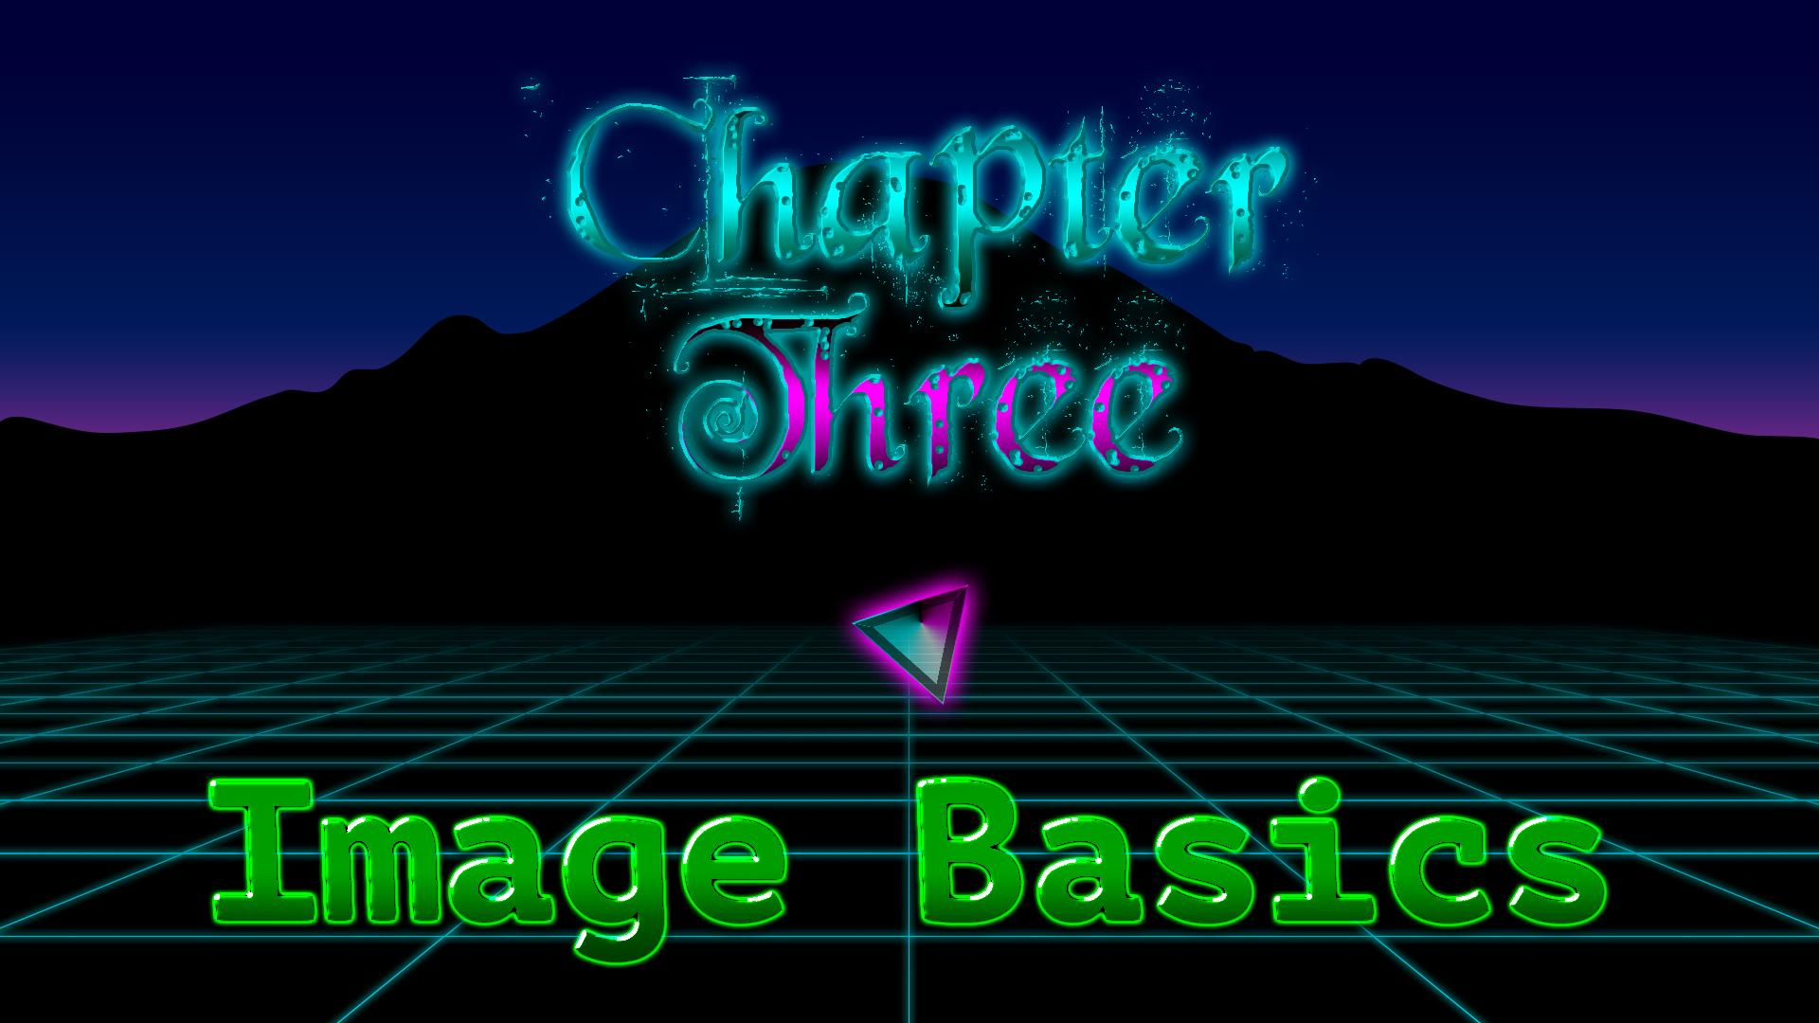

Slide 2
So what is an image?

Slide 3
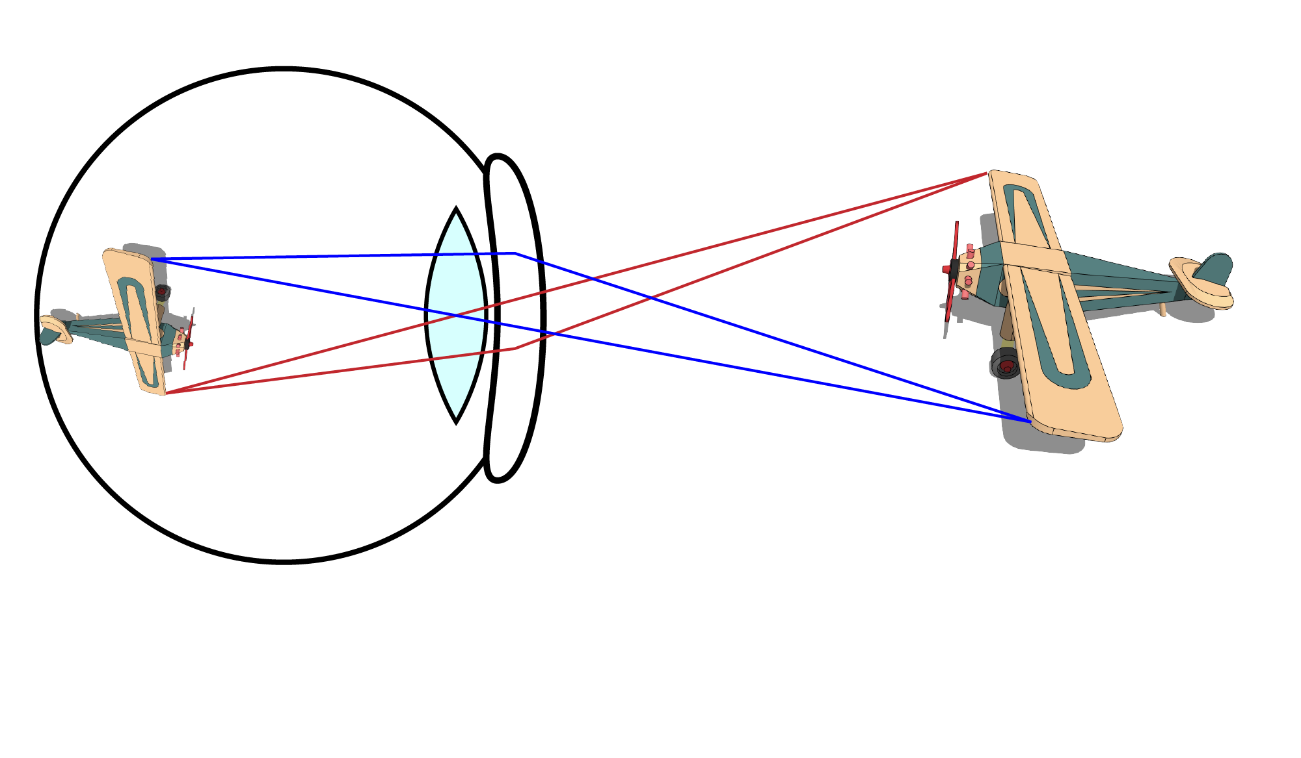
Eyes: projection onto retina

Slide 4
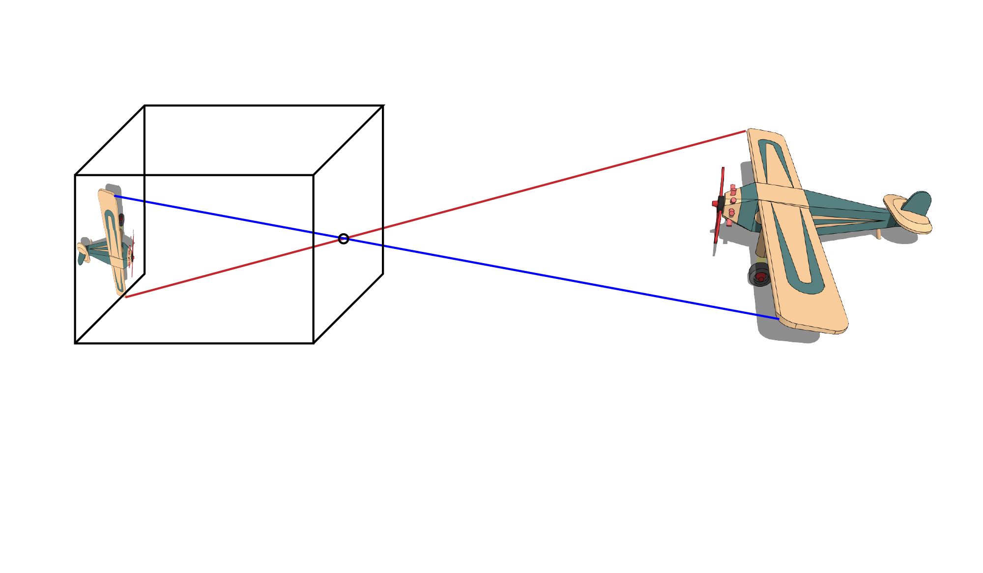
Model: pinhole camera

Slide 5
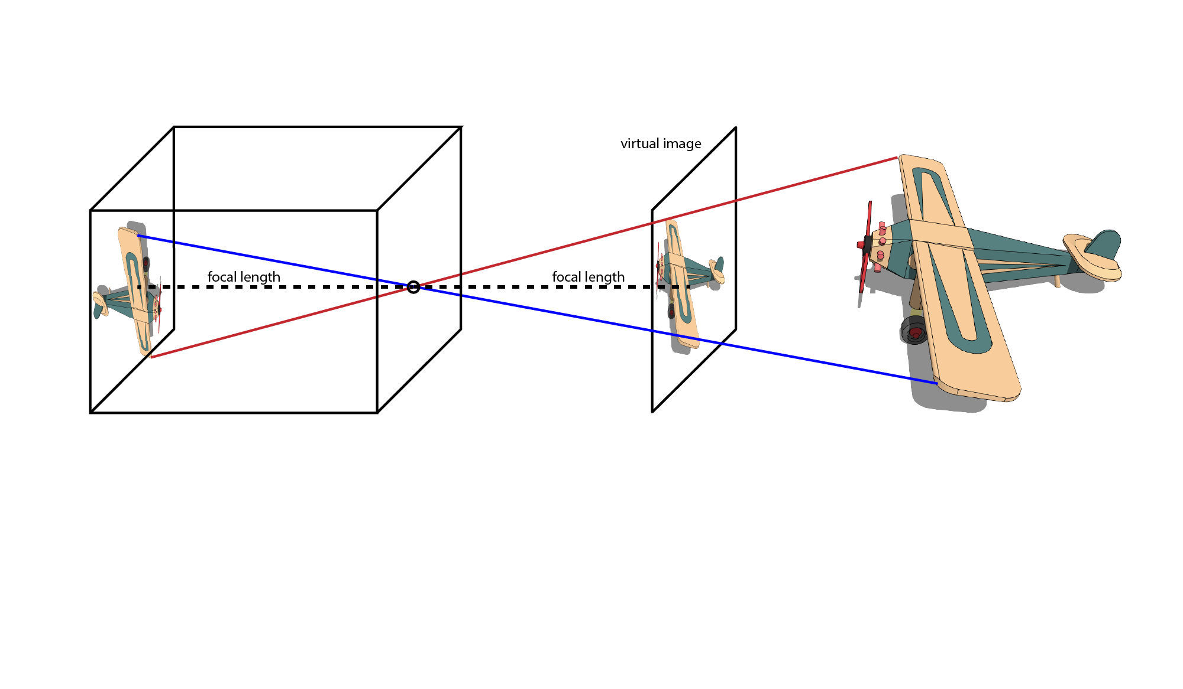
Model: pinhole camera

Slide 6
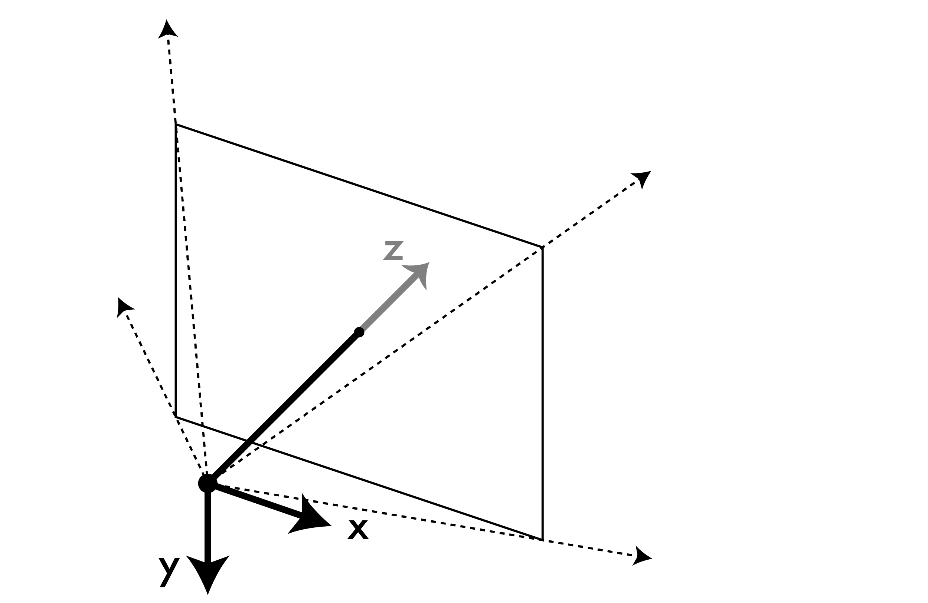
Image: 3d -> 2d projection of the world

Slide 7
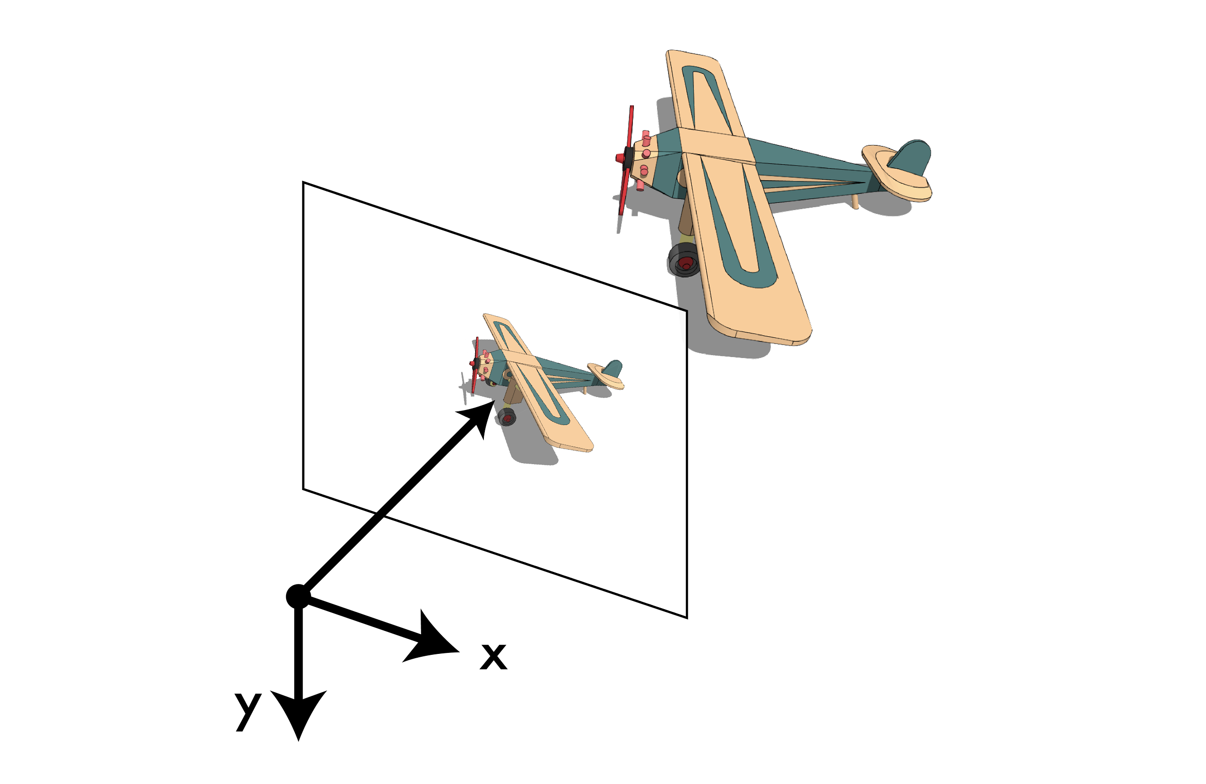
Image: 3d -> 2d projection of the world

Slide 8

Image: 3d -> 2d projection of the world

Slide 9
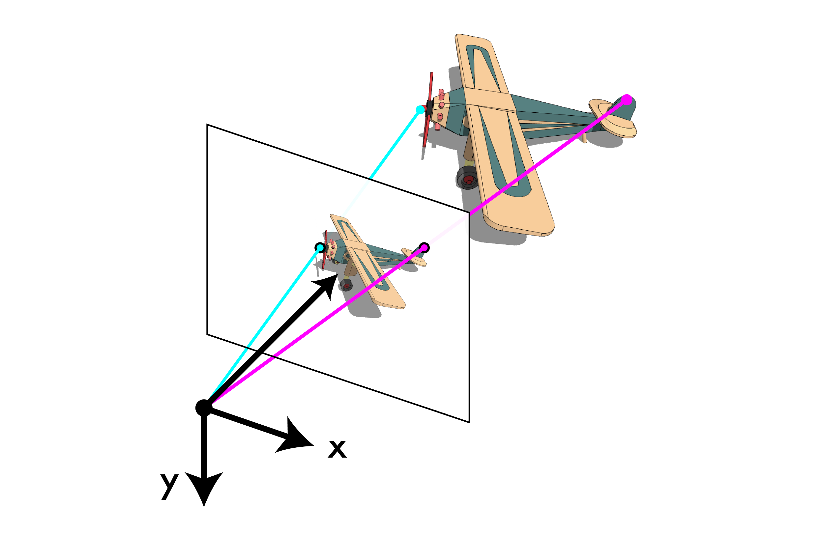
Image: 3d -> 2d projection of the world

Slide 10
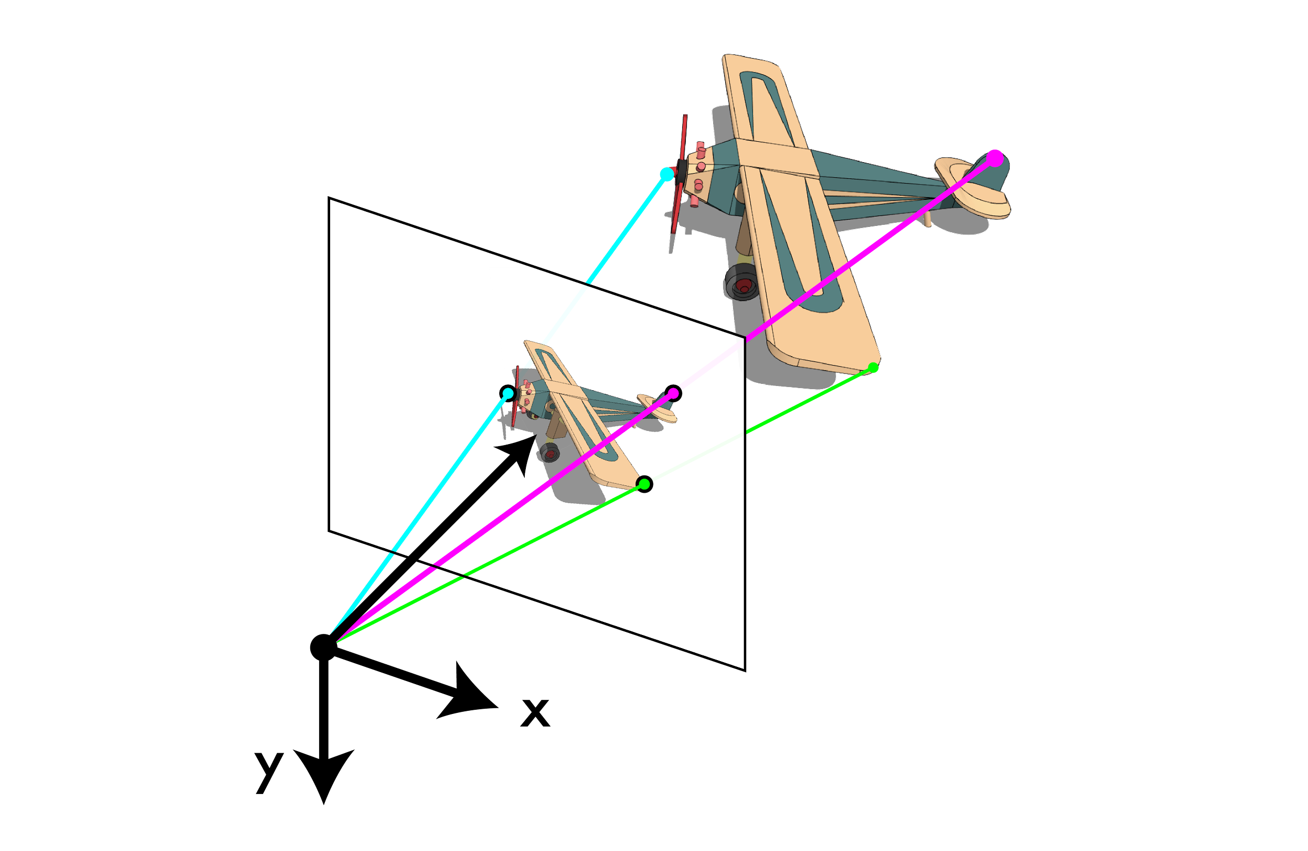
Image: 3d -> 2d projection of the world

Slide 11

Image: 3d -> 2d projection of the world

Slide 12
At each point we record incident light

Slide 13
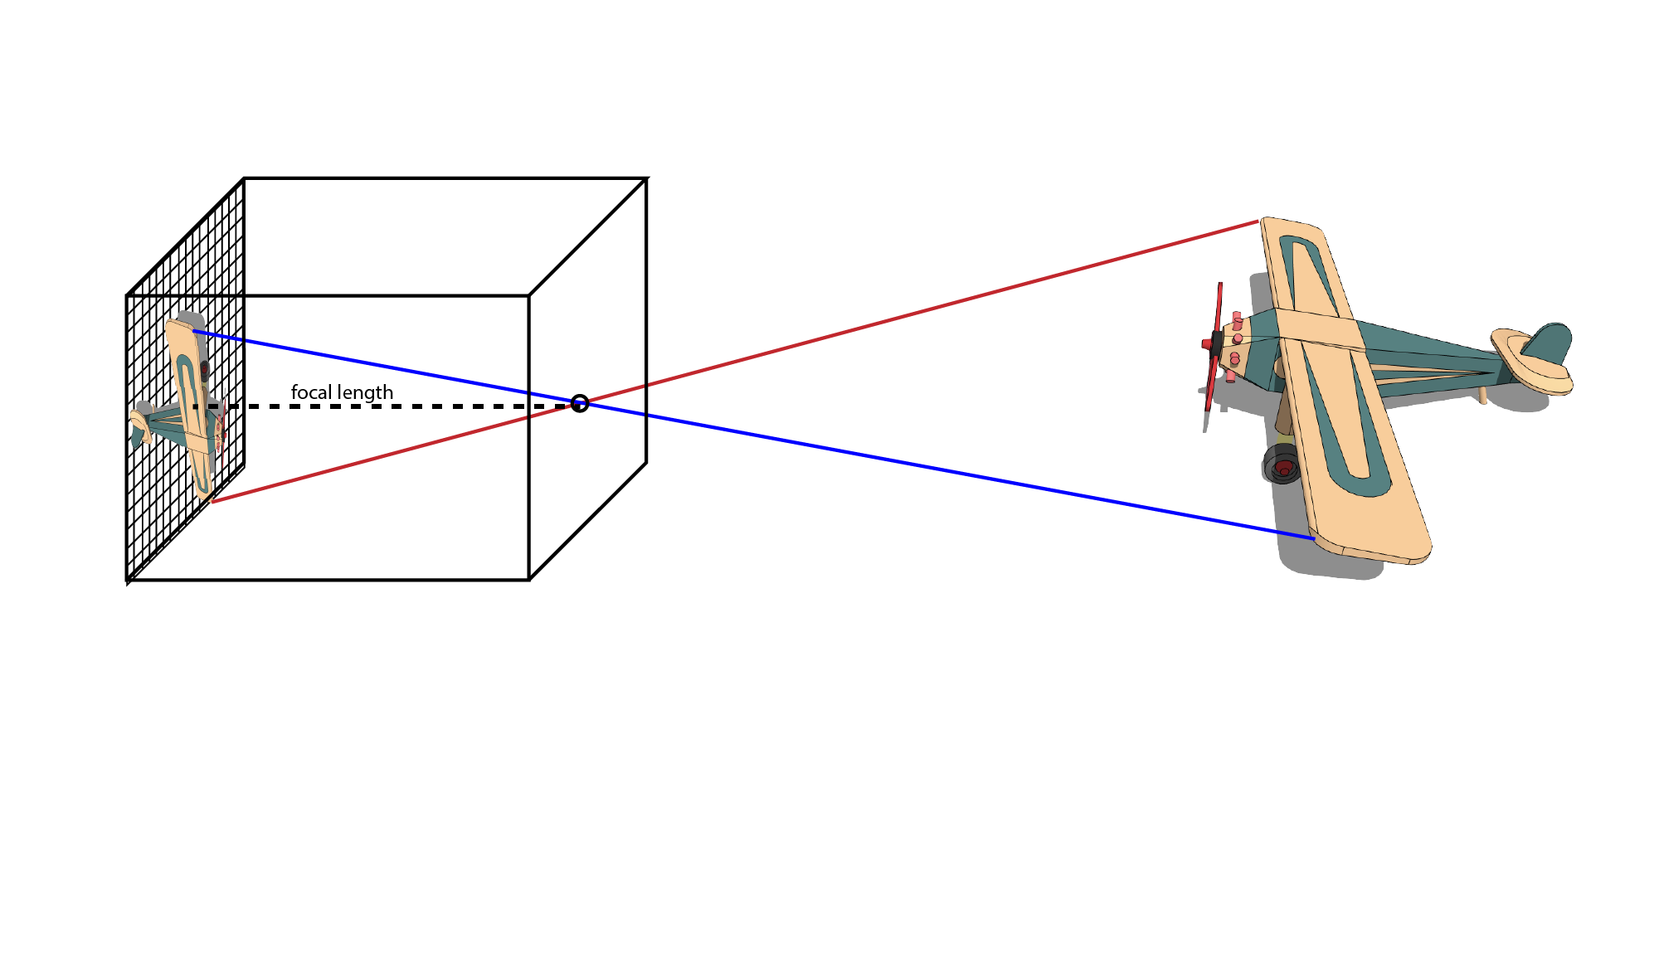
At each point we record incident light

Slide 14
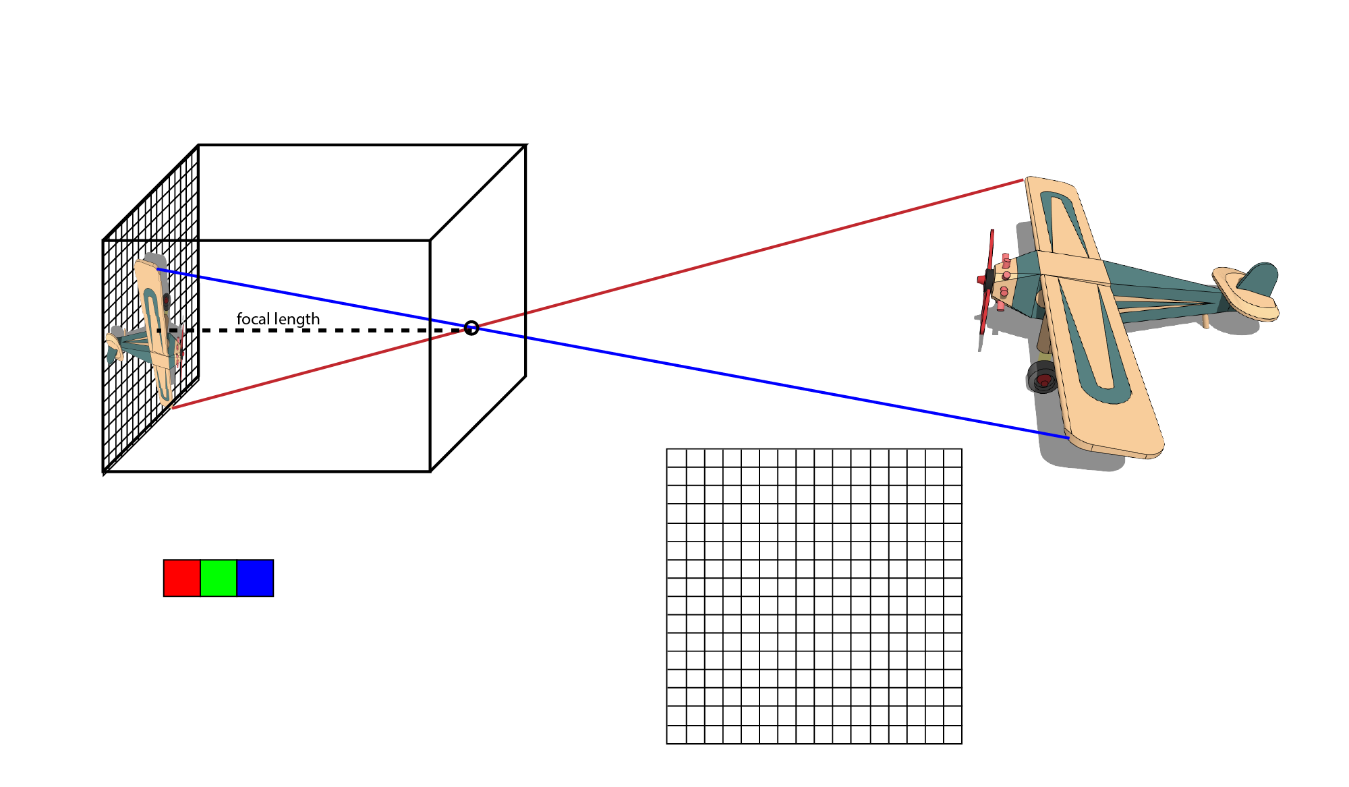
How do we record color?

Slide 15
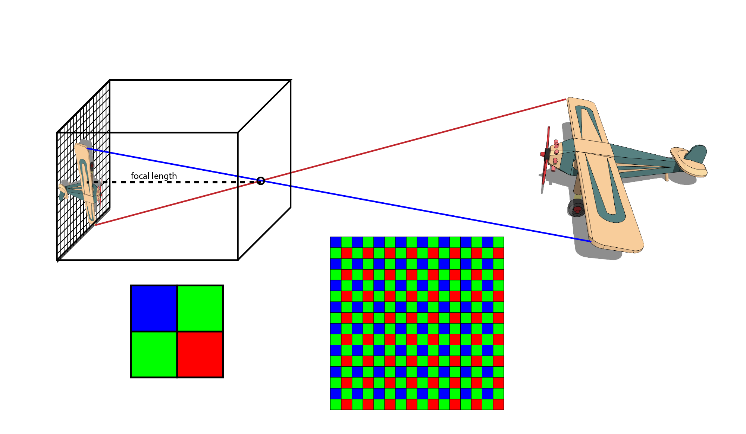
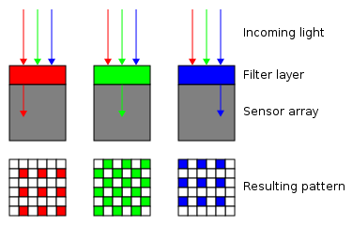
Bayer pattern for CMOS sensors

Slide 16
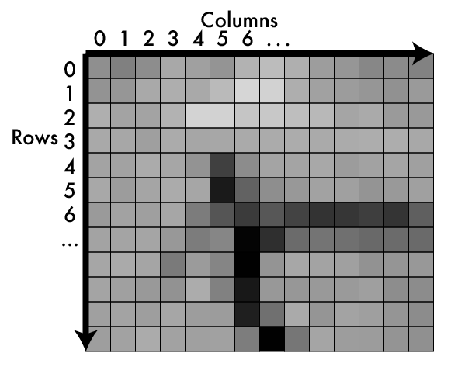
An image is a matrix of light

Slide 17

Values in matrix = how much light

Slide 18
Values in matrix = how much light
Higher = more light
Lower = less light
Bounded
No light = 0
Sensor/device limit = max
Typical ranges:
[0-255], fit into byte
[0-1], floating point
Called pixels

Slide 19
Addressing pixels
Ways to index:
(x,y)
Like cartesian coordinates
(3,6) is column 3 row 6
(r,c)
Like matrix notation
(3,6) is row 3 column 6
I use (x,y)
So does your homework!
Arbitrary
Only thing that matters is consistency

Slide 20
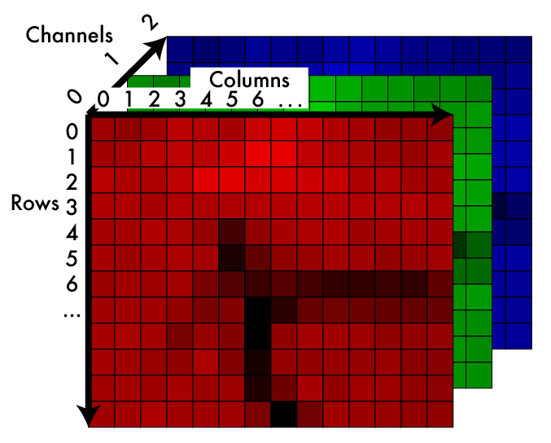
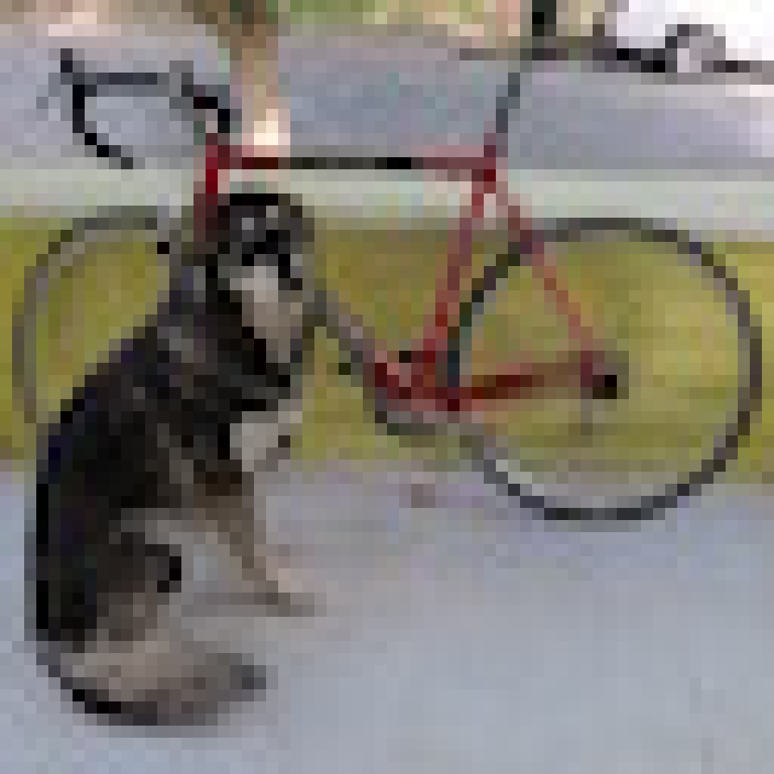
Color image: 3d tensor in colorspace

Slide 21
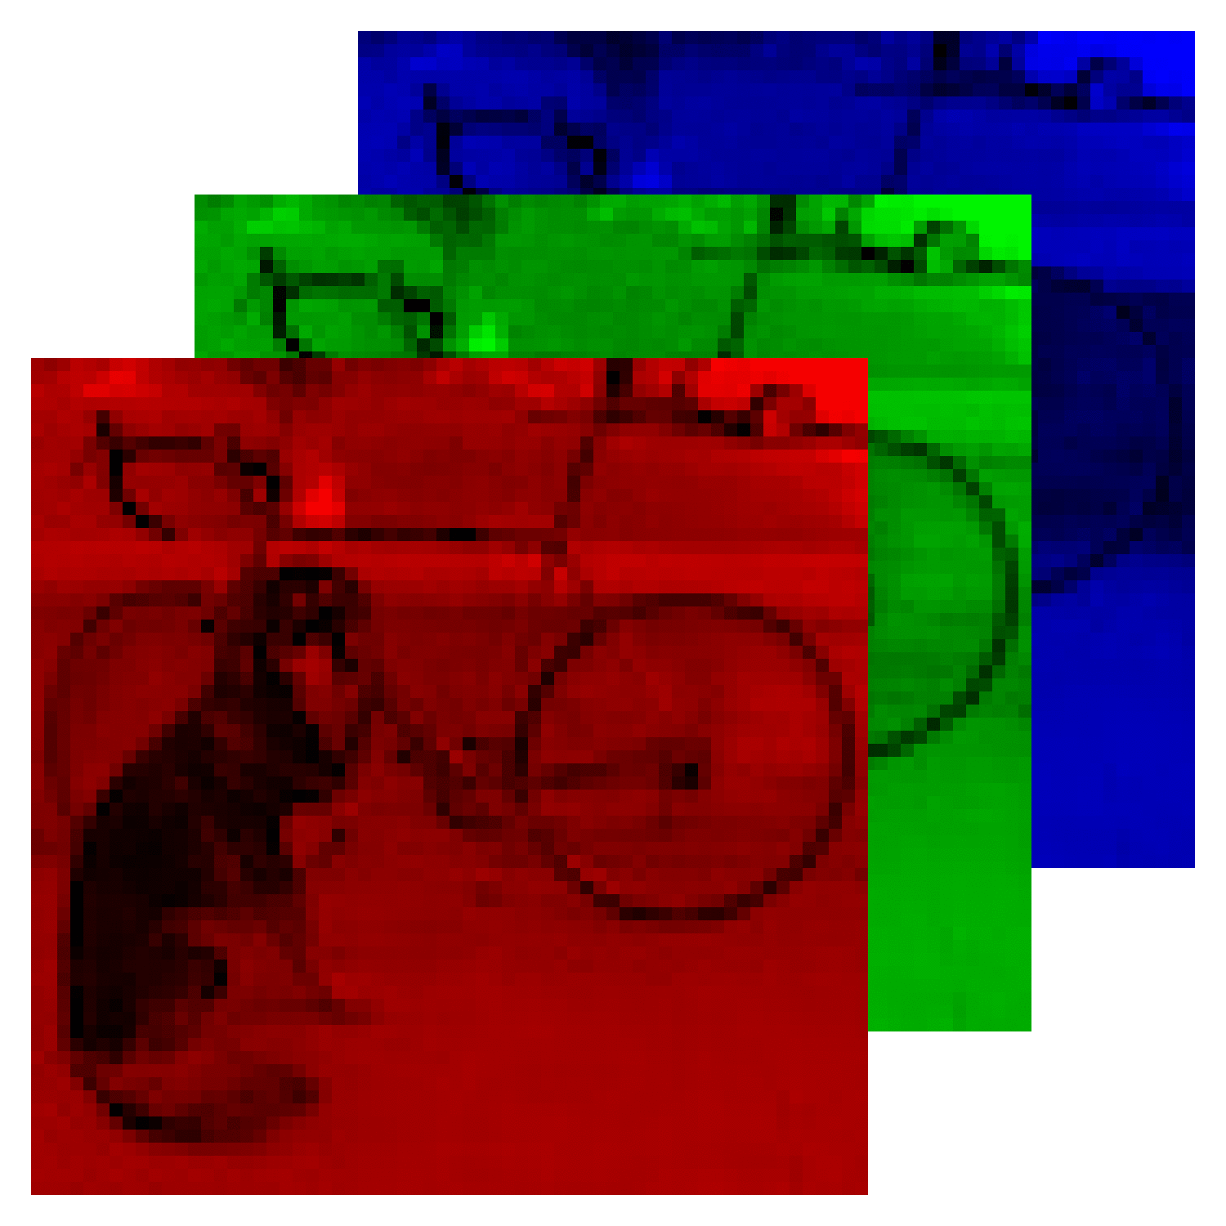
RGB information in separate “channels”
Remember: we can match “real” colors using a mix of primaries.
Each channel encodes one primary. Adding the light produced from each primary mimics the original color.

Slide 22
Addressing pixels
I use (x,y,c)
(1,2,0):
column 1, row 2, channel 0
Still doesn’t matter, just be consistent
But do what I do for homeworks :-)
Also for size:
1920 x 1080 x 3 image:
1920 px wide
1080 px tall
3 channels

Slide 23
How do we store them?
129 | 131 | 152 | 159 | 135 | 163 | 142 | 82 | 182 | ...

Slide 24
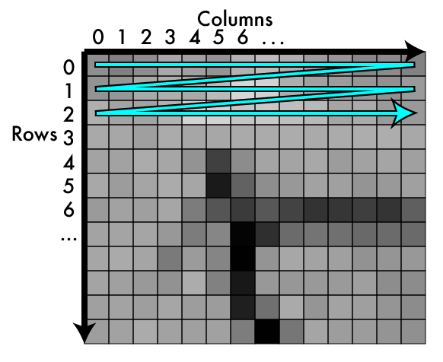
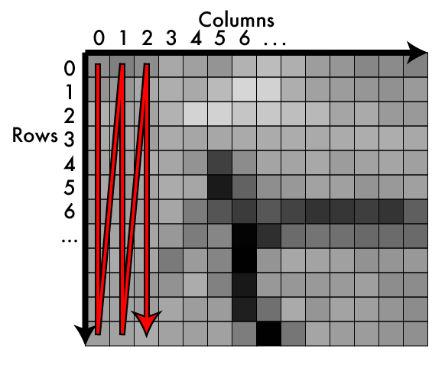
Storage: row major vs column major

Slide 25
Storage: row major vs column major
HW
WH

Slide 26
Typically use row-major or HW

Slide 27
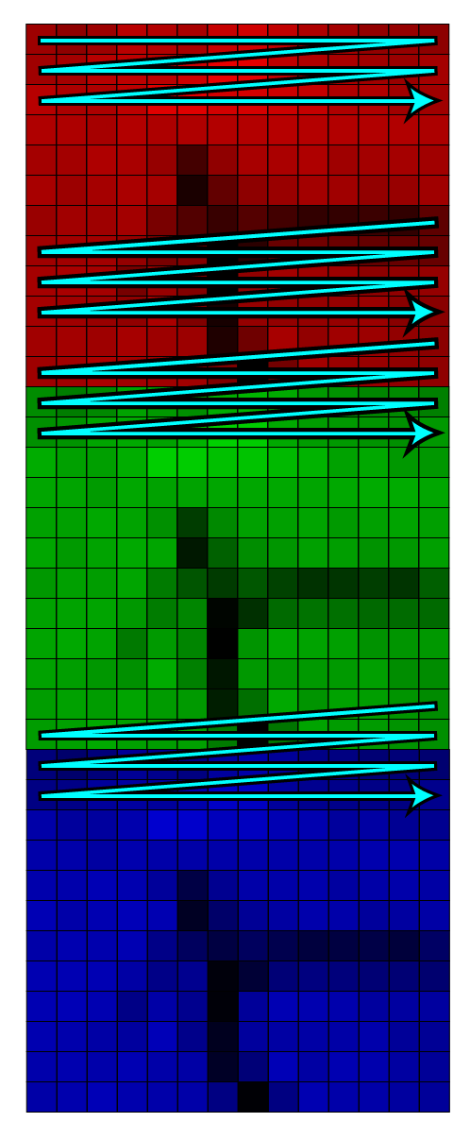
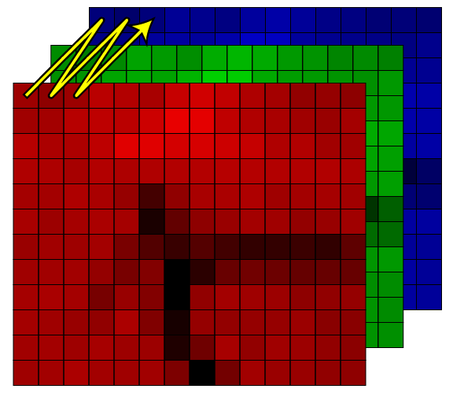
In 3d we have more choices!

Slide 28
HWC: channels interleaved
129 | 131 | 152 | 159 | 135 | 163 | 142 | 82 | 182 | ...

Slide 29
CHW: channels separated
129 | 131 | 152 | ... | 135 | 163 | 142 | ... | 182 | ...

Slide 30
CHW Pop quiz
We’ll use CHW, it’s what a lot of other libraries use.
In an array for a 1920 x 1080 x 3 image what entry would contain the pixel (15,192,2)?

Slide 31
CHW Pop quiz
In an array for a 1920 x 1080 x 3 image what entry would contain the pixel (15,192,2)?
In general for (x,y,z) of image (W,H,C)
x + y*W + z*W*H
15 + 192*1920 + 2*1920*1080 = 4,515,855
Remember, everything is 0 indexed
This isn’t MATLAB 🙃

Slide 32
In your homework
typedef struct {
int w,h,c;
float *data;
} image;

Slide 33
Fun with other colorspaces!

Slide 34
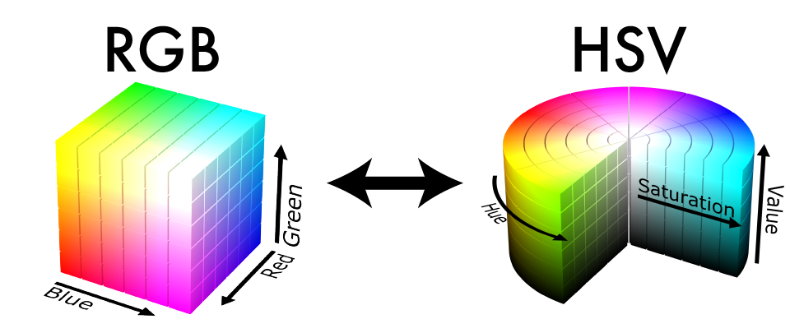
Other colorspaces are fun!

Slide 35
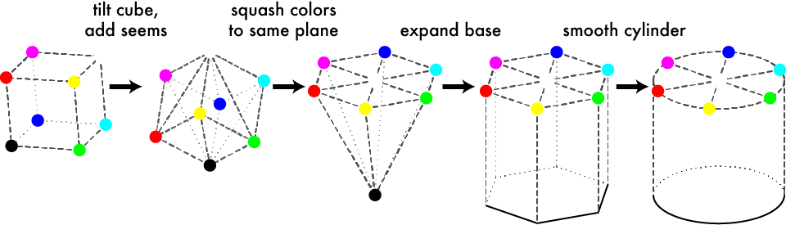
Geometric HSV to RGB:

Slide 36
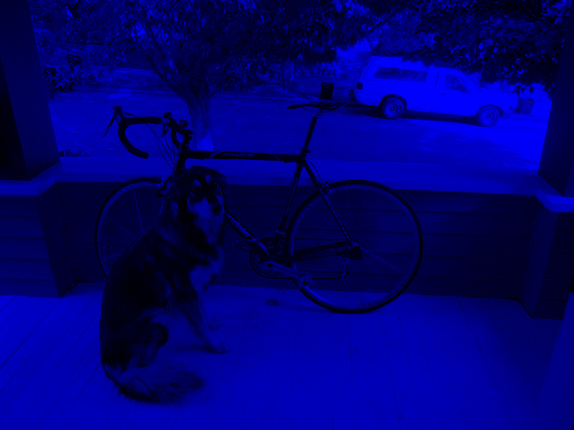
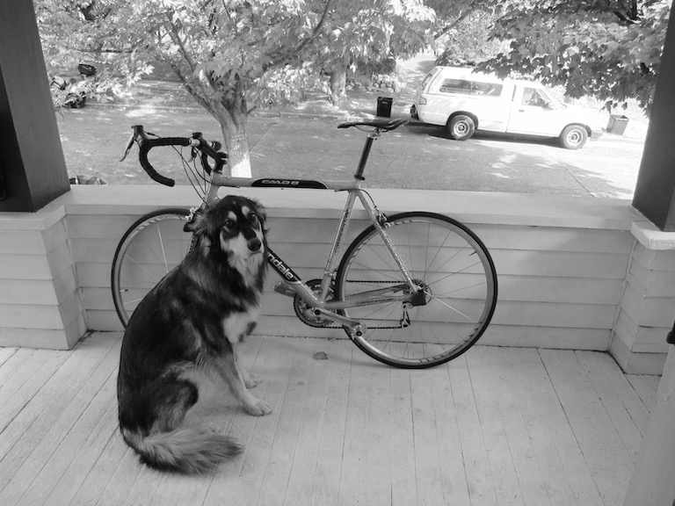
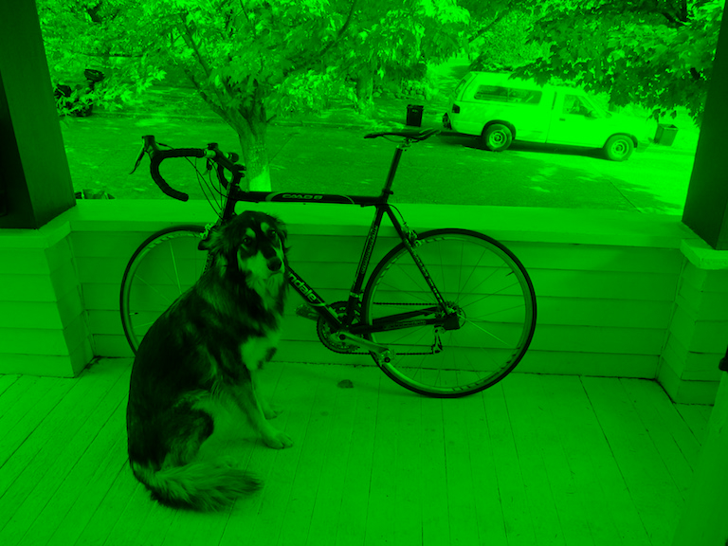
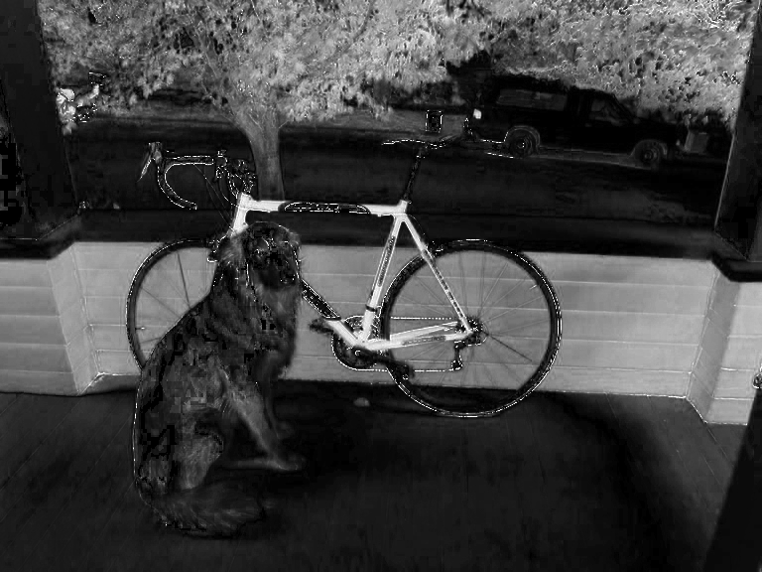
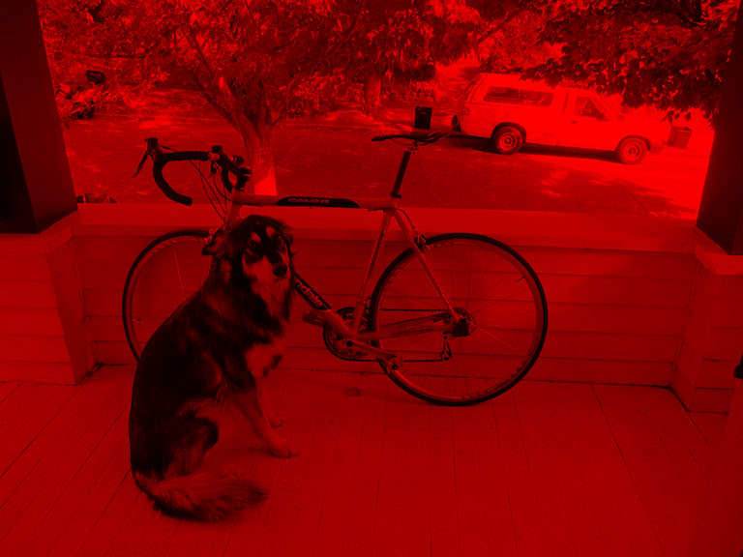
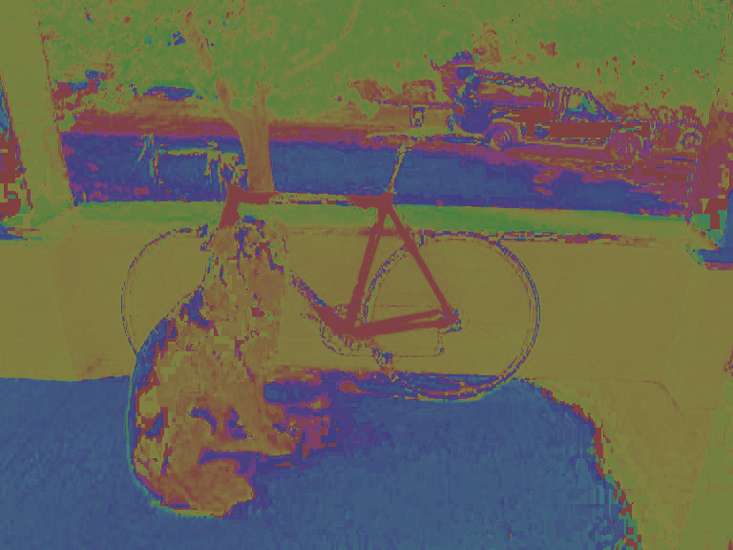
Still 3d tensor, different info

Slide 37
Hue Saturation Value

Slide 38
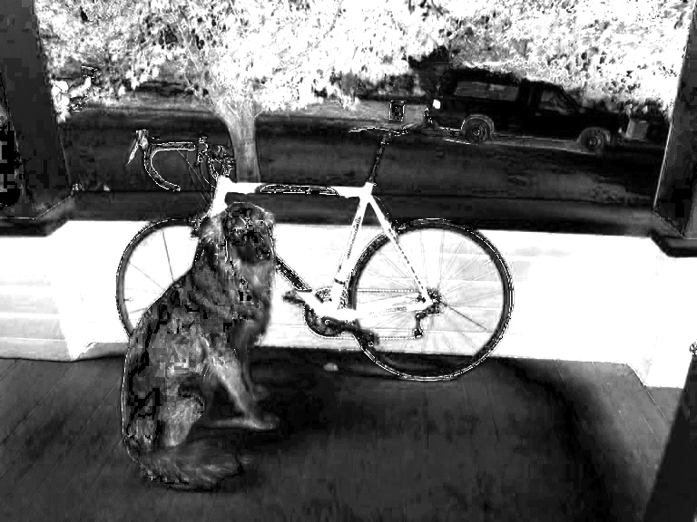
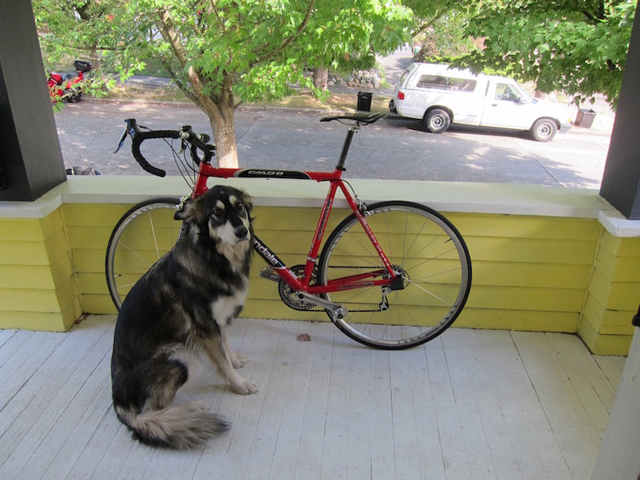
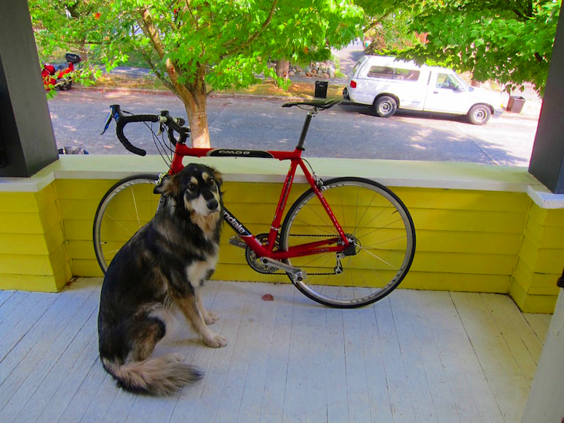
More saturation = intense colors
2x

Slide 39
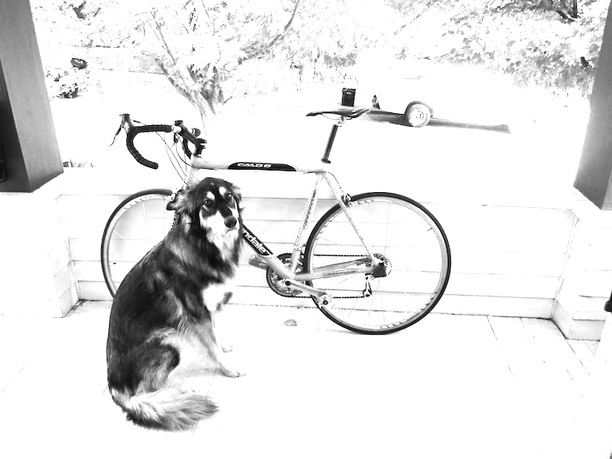
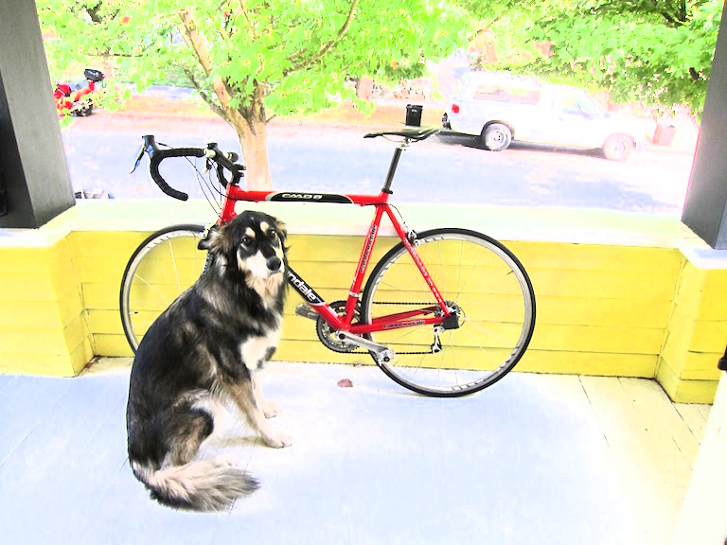
More value = lighter image
2x

Slide 40
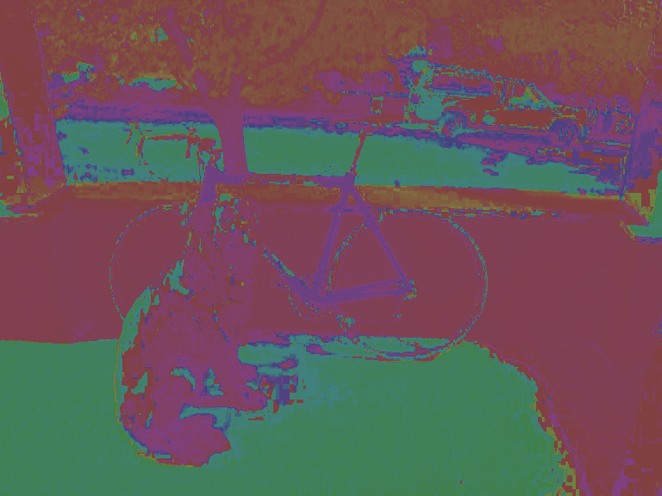
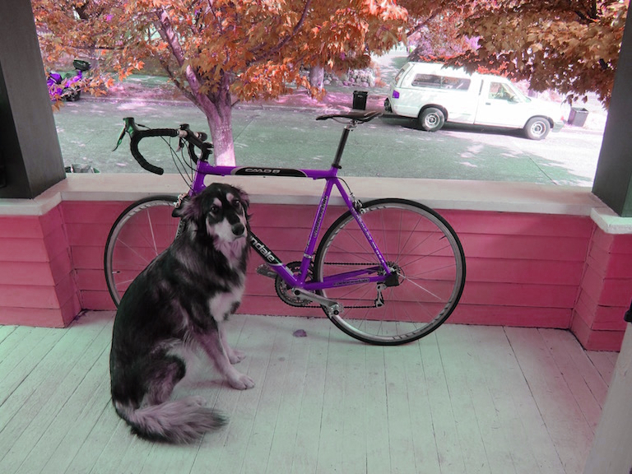
Shift hue = shift colors
-.2

Slide 41

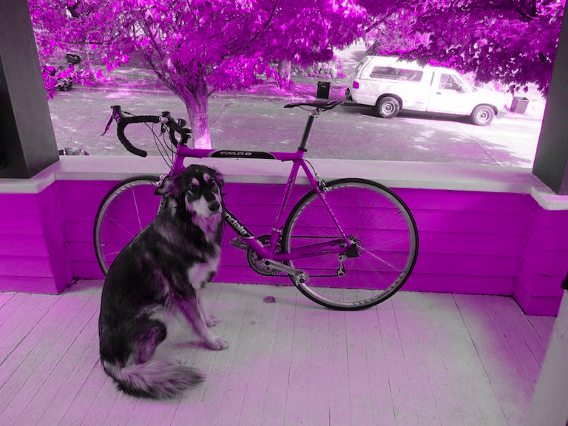
Set hue to your favorite color!

Slide 42

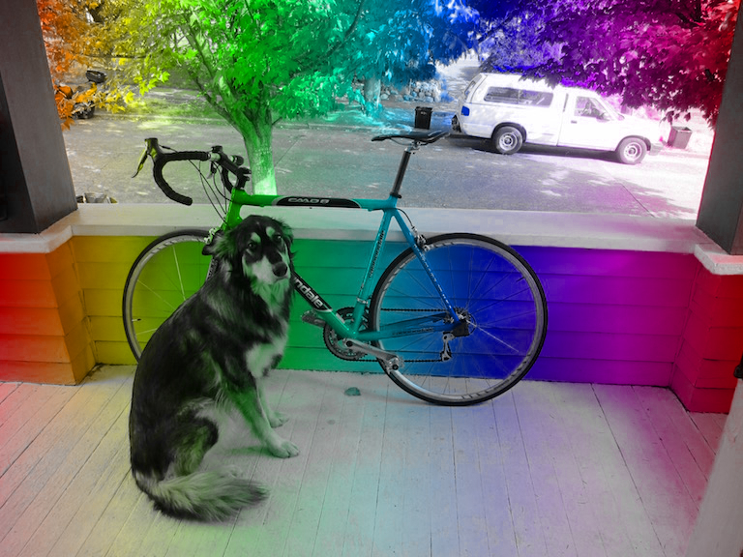
Or pattern...

Slide 43
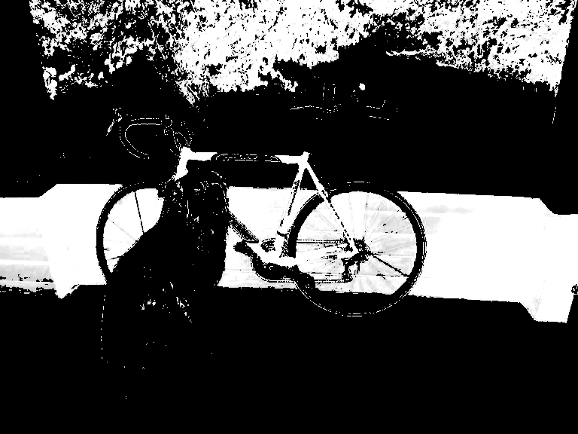
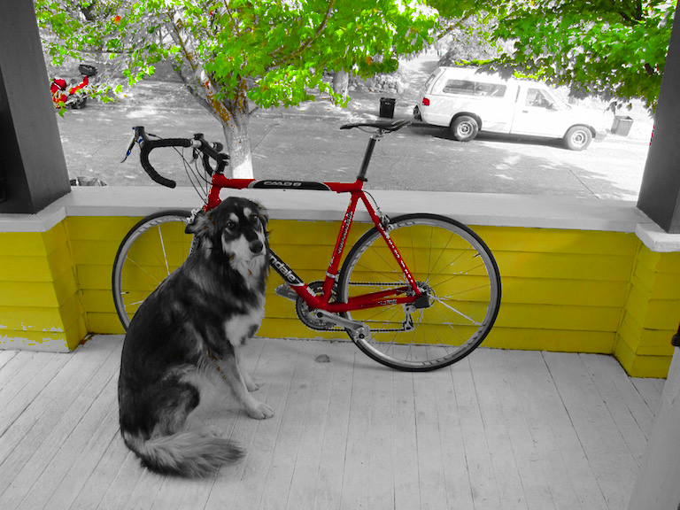
Increase and threshold saturation

Slide 45
Image interpolation and resizing

Slide 46
An image is kinda like a function
An image is a mapping from indices to pixel value:
Im: I x I x I -> R
We may want to pass in non-integers:
Im’: R x R x I -> R

Slide 47
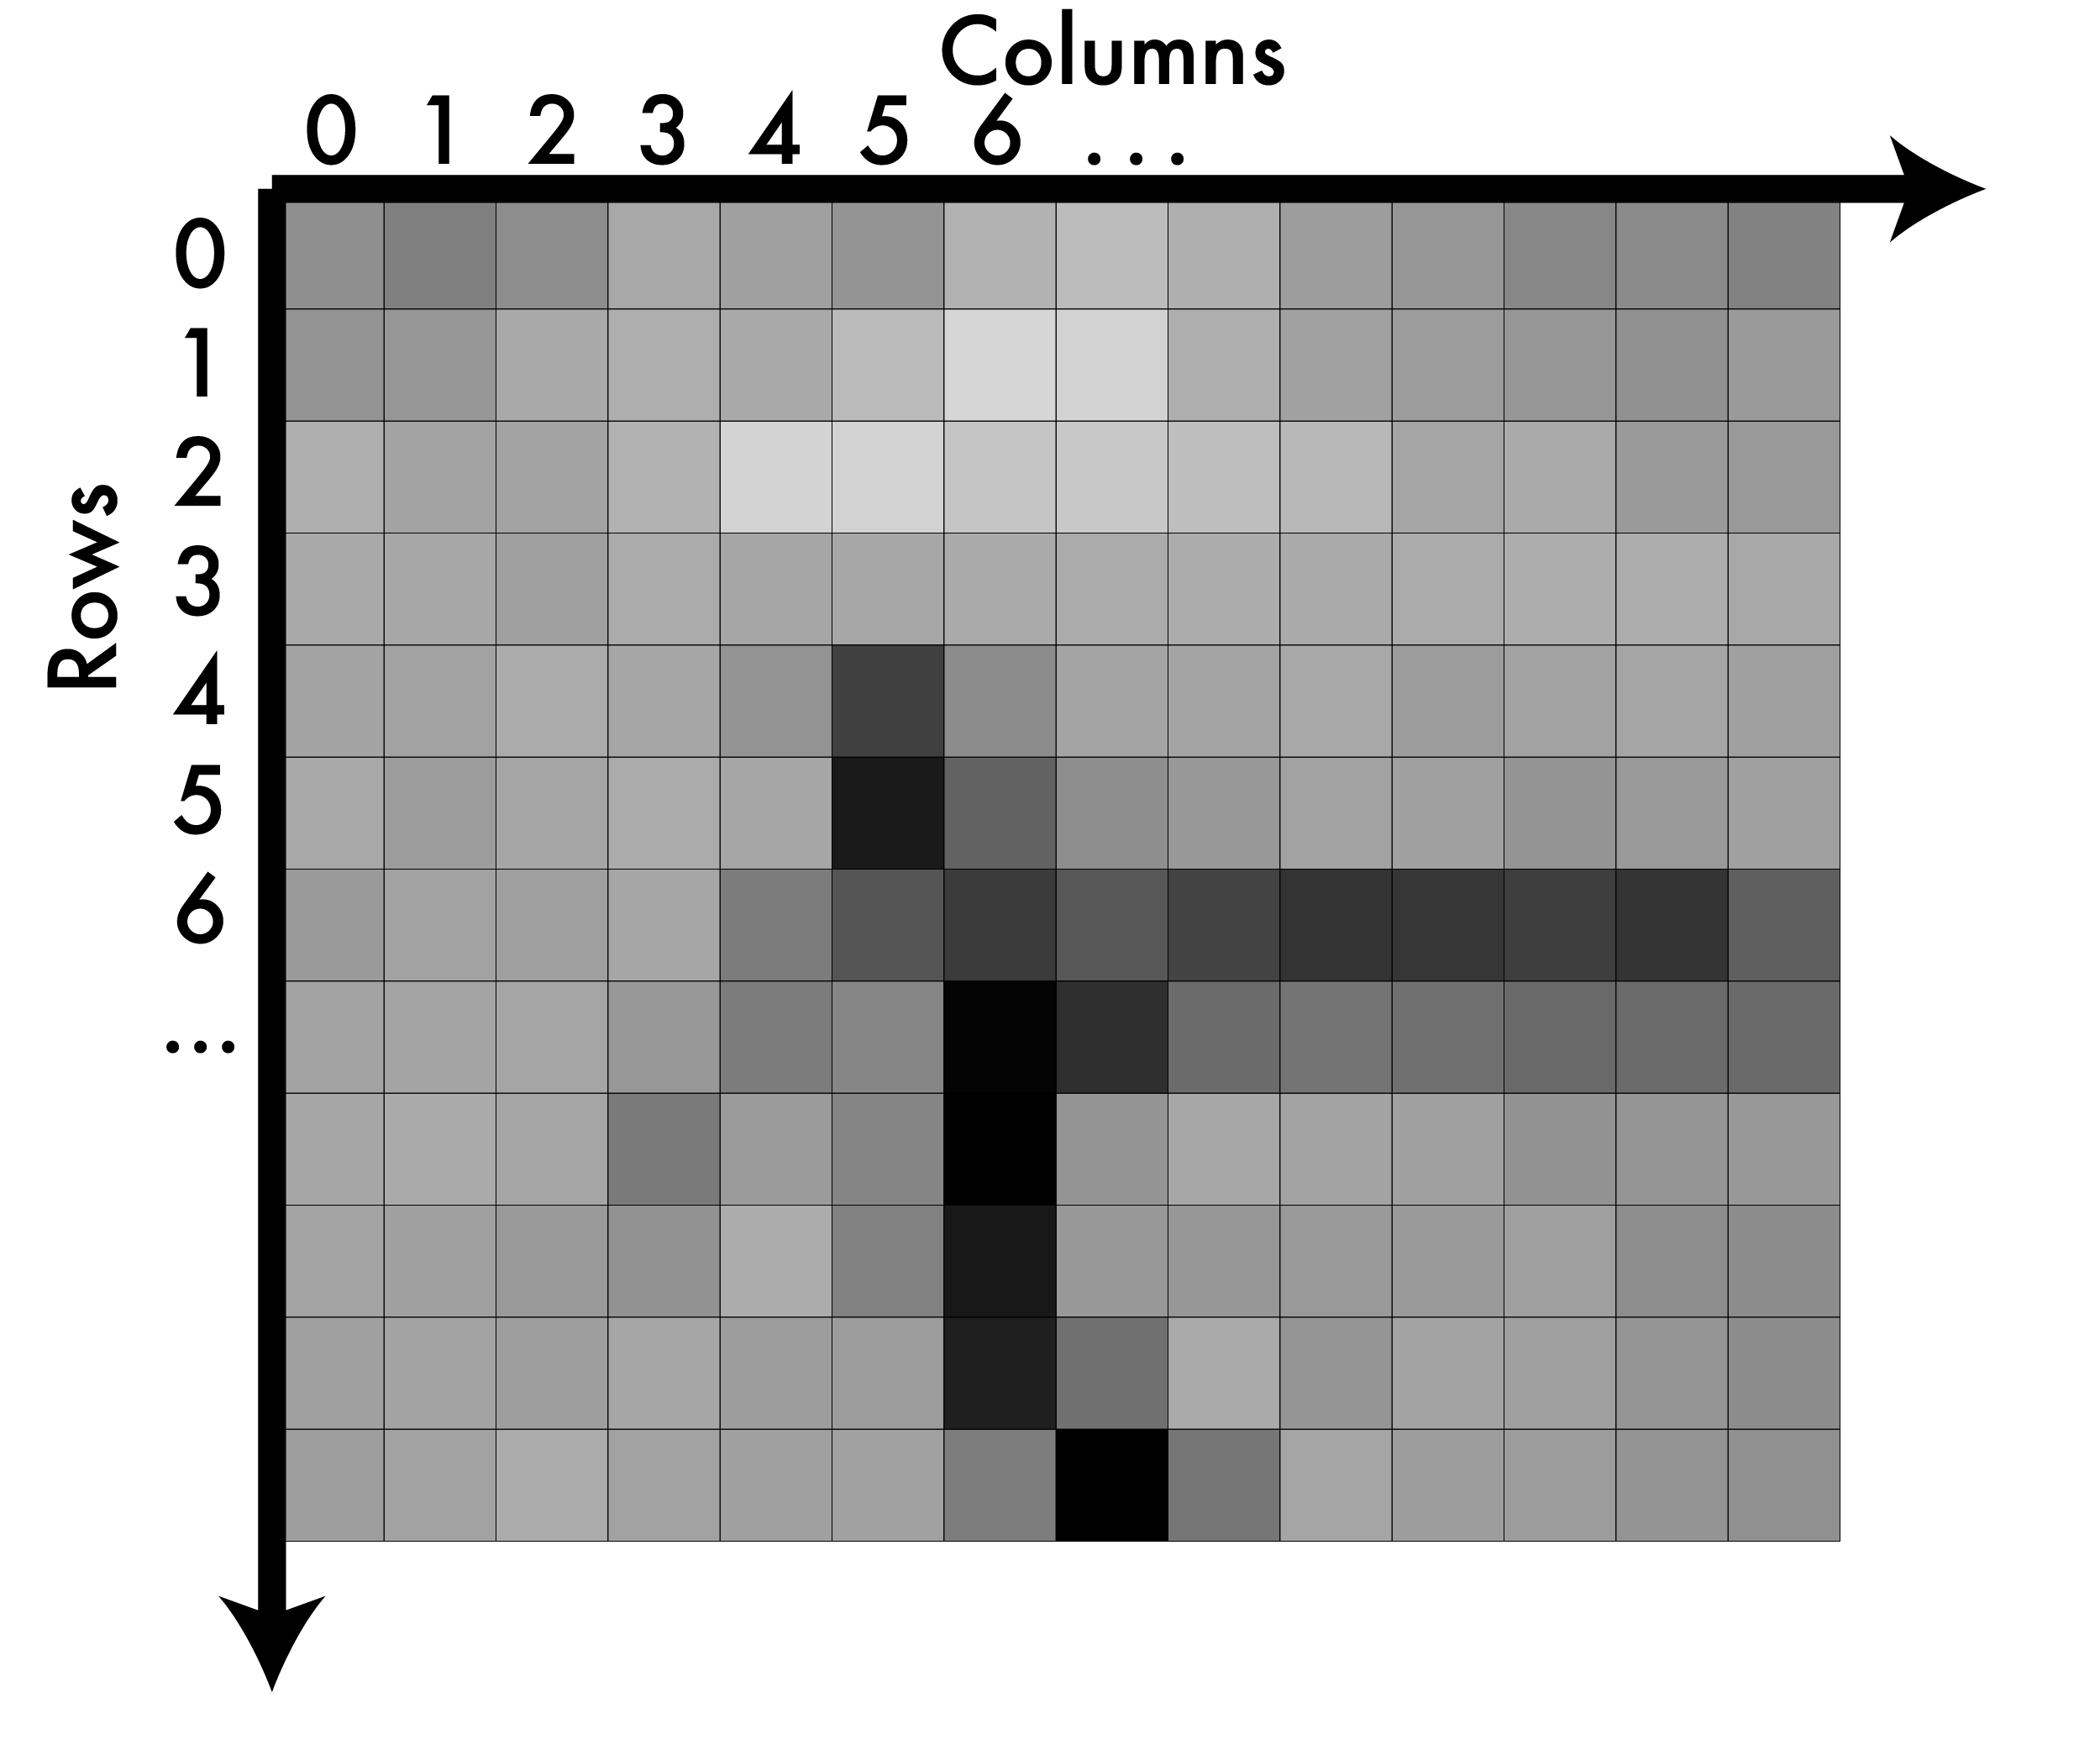
A note on coordinates in images

Slide 48
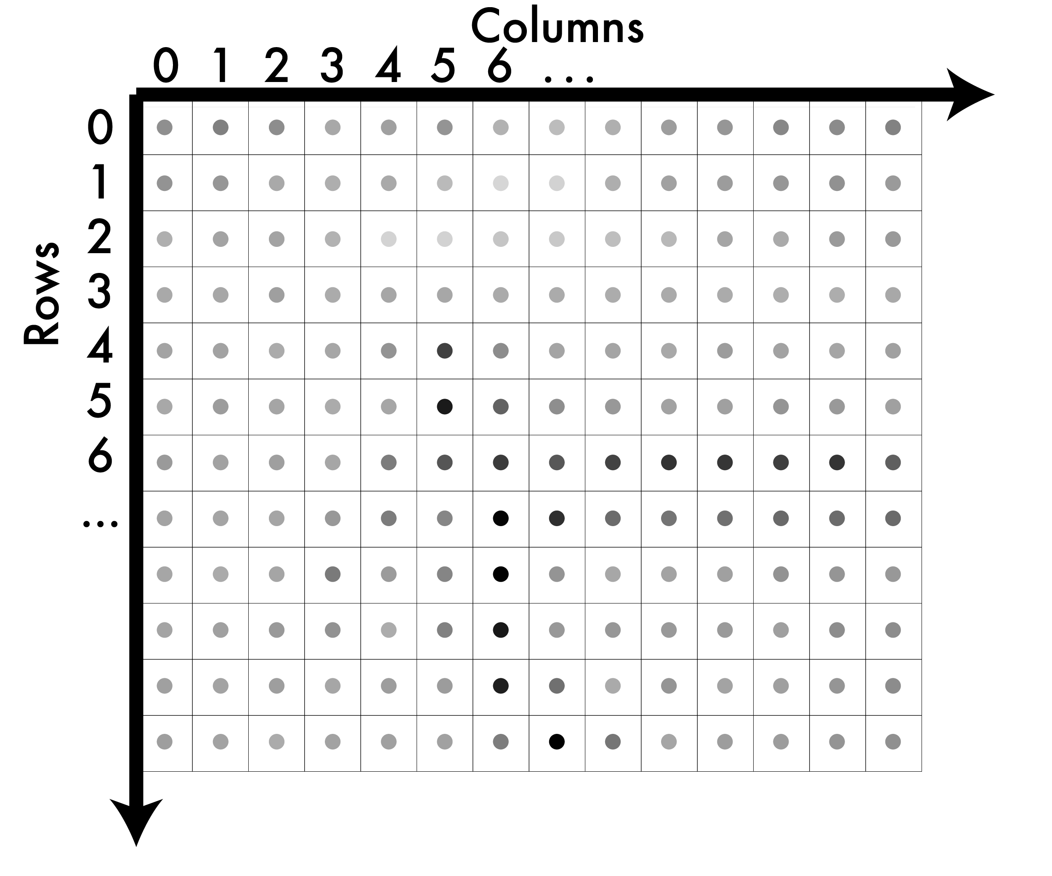
A note on coordinates in images

Slide 49
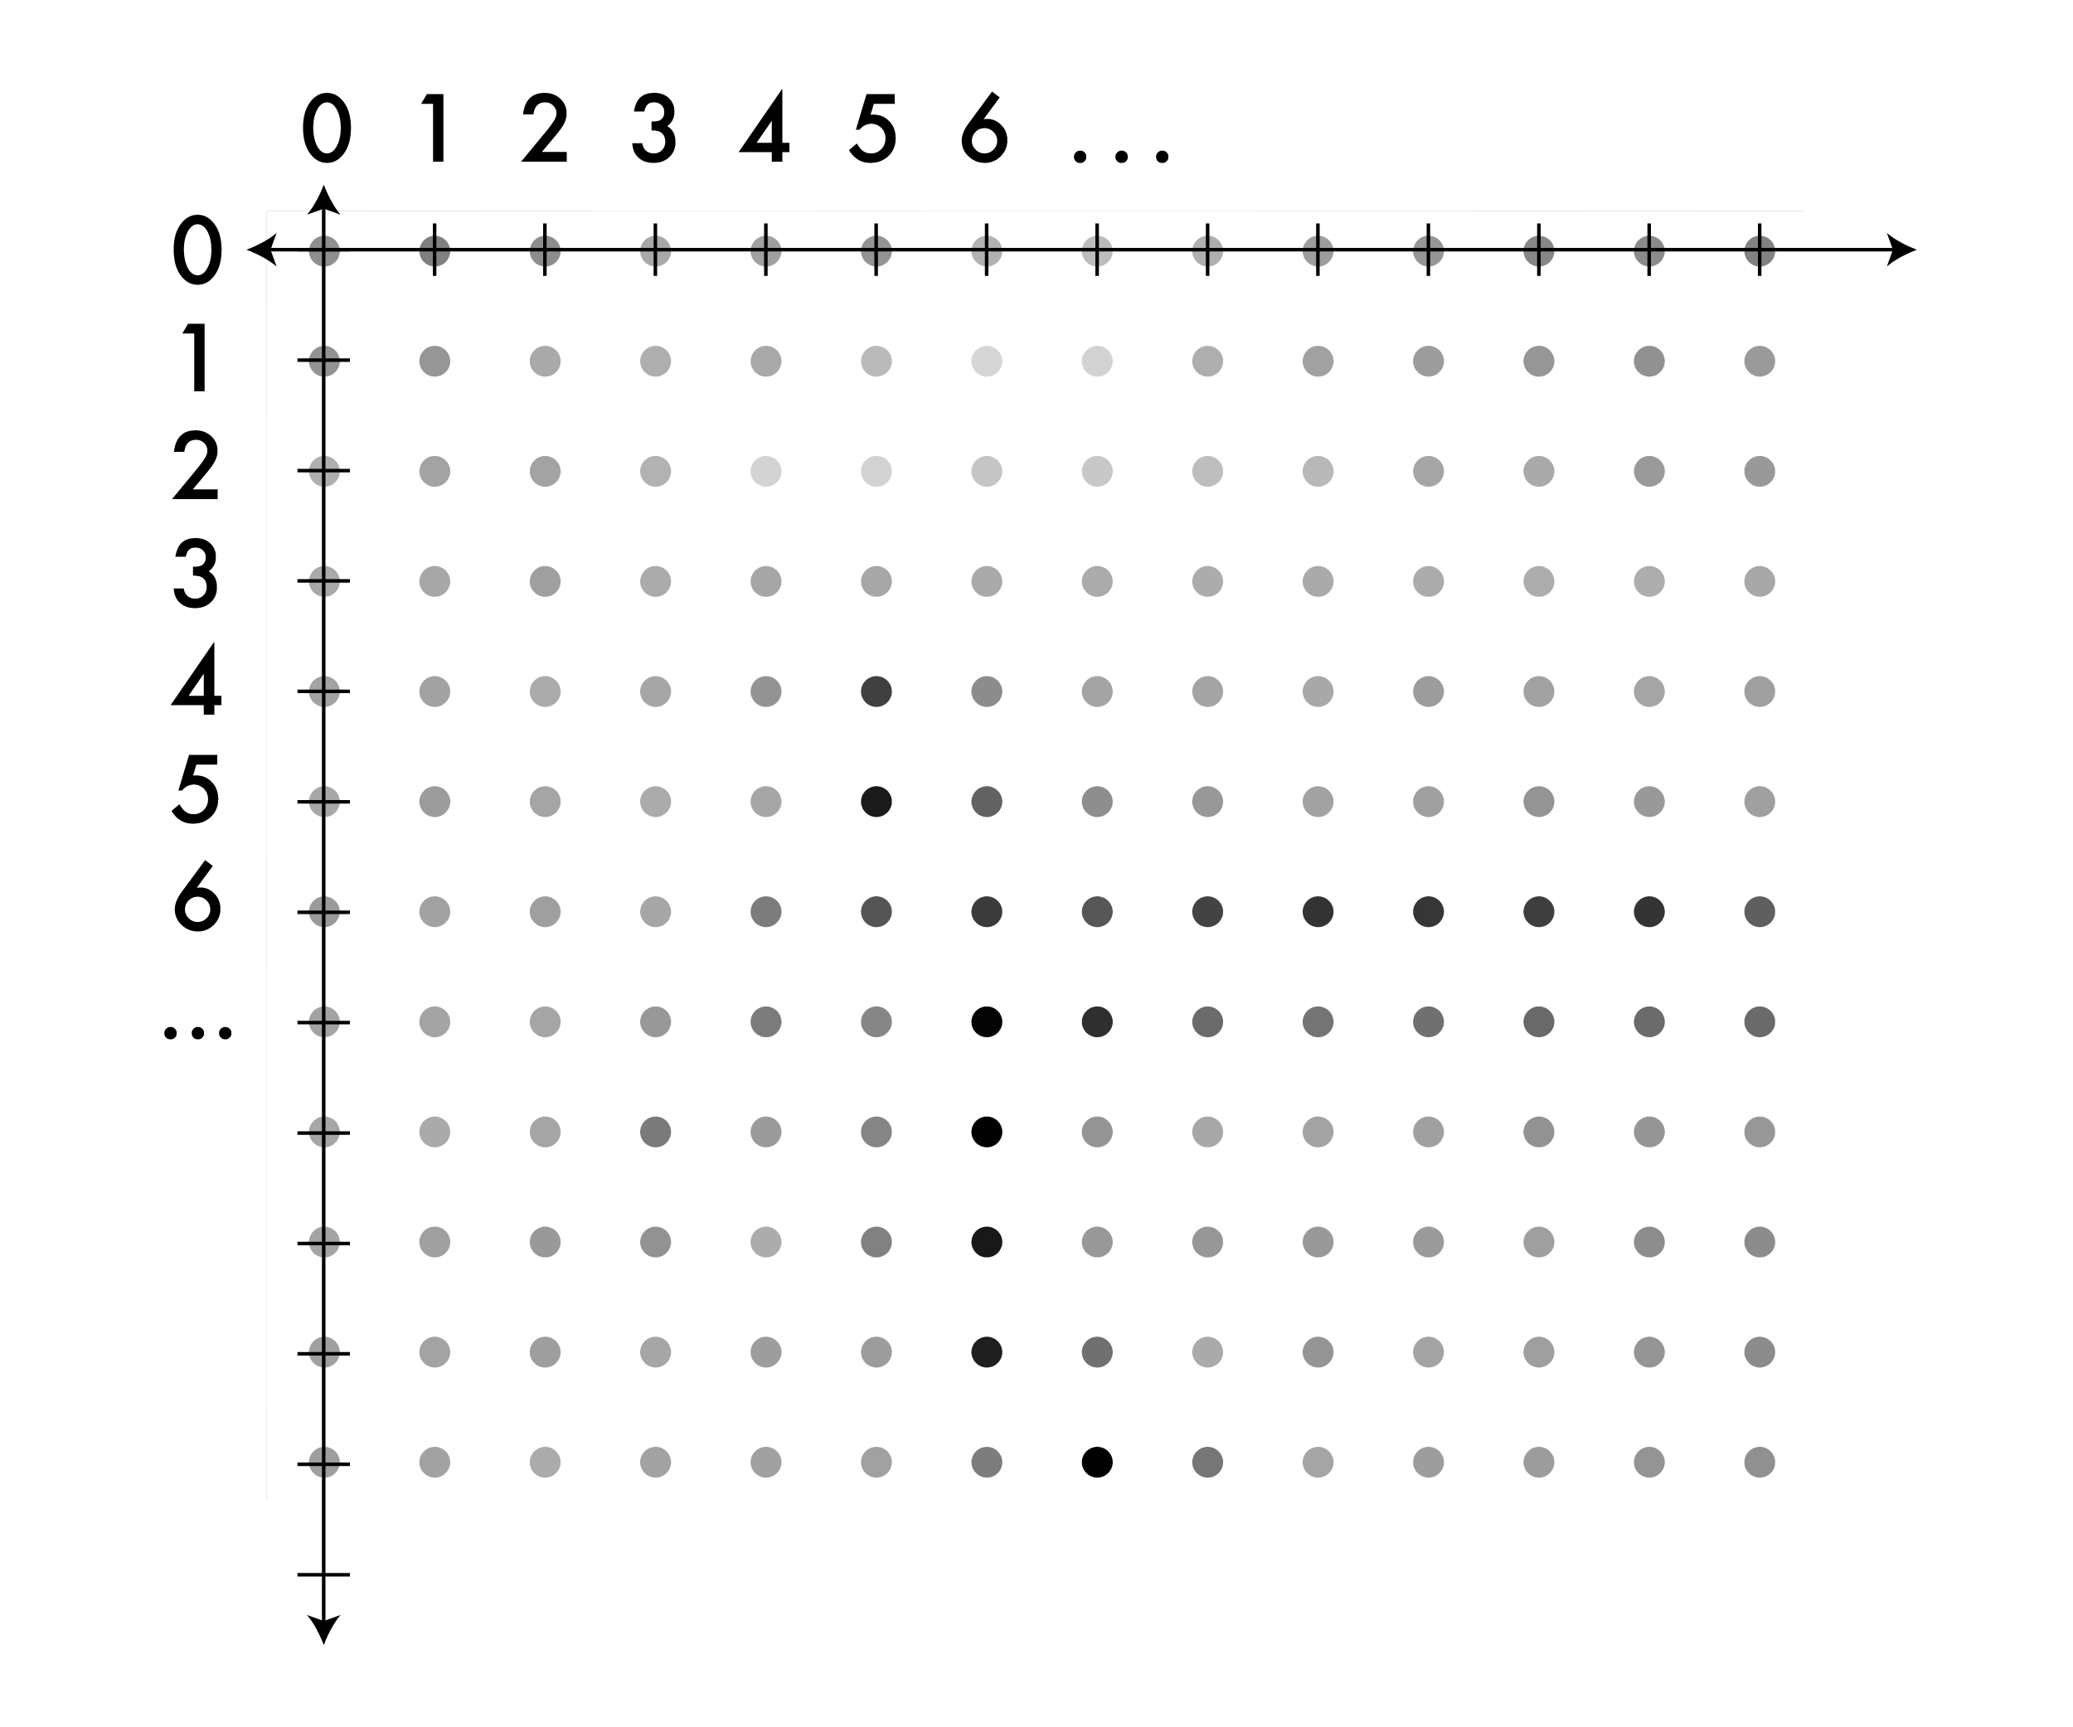
A note on coordinates in images

Slide 50
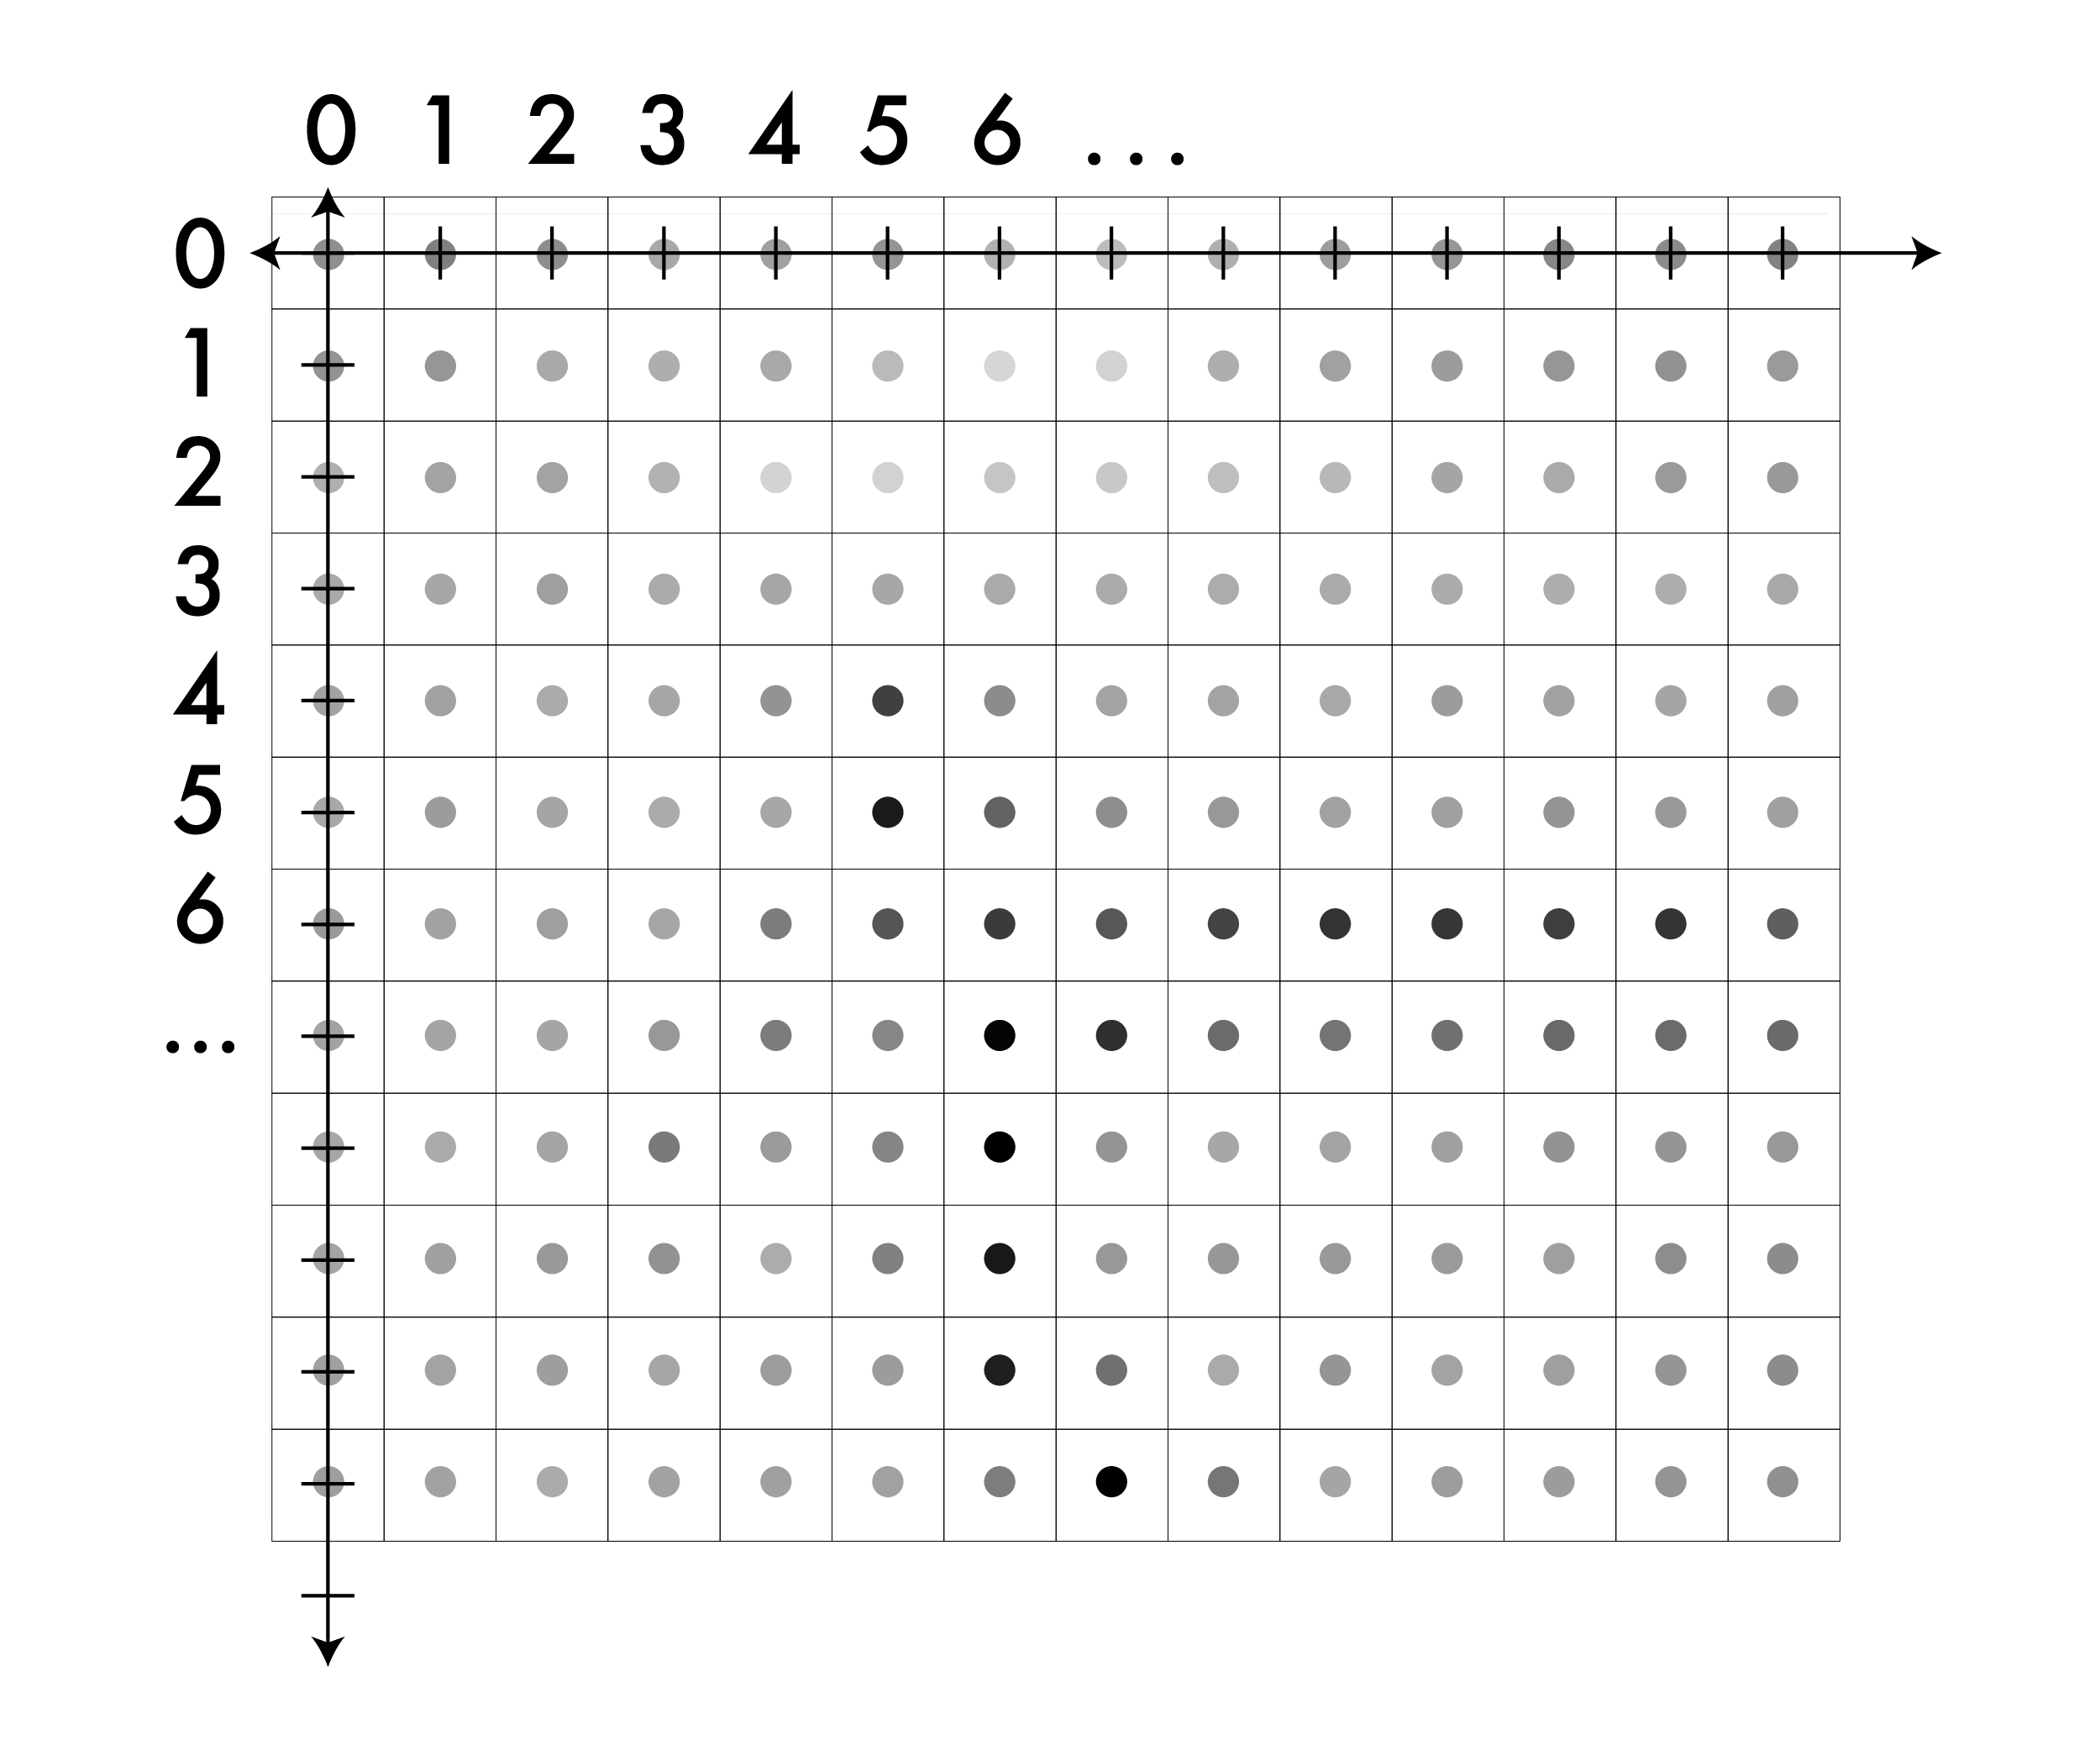
A note on coordinates in images

Slide 51
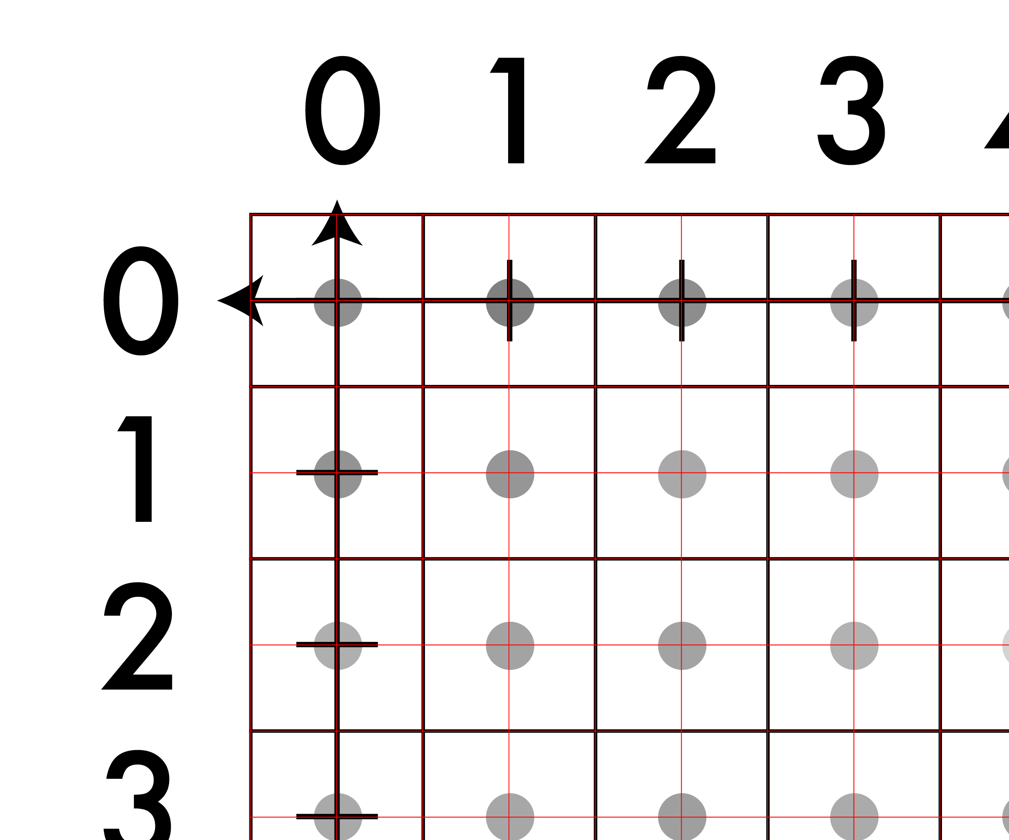
A note on coordinates in images

Slide 52
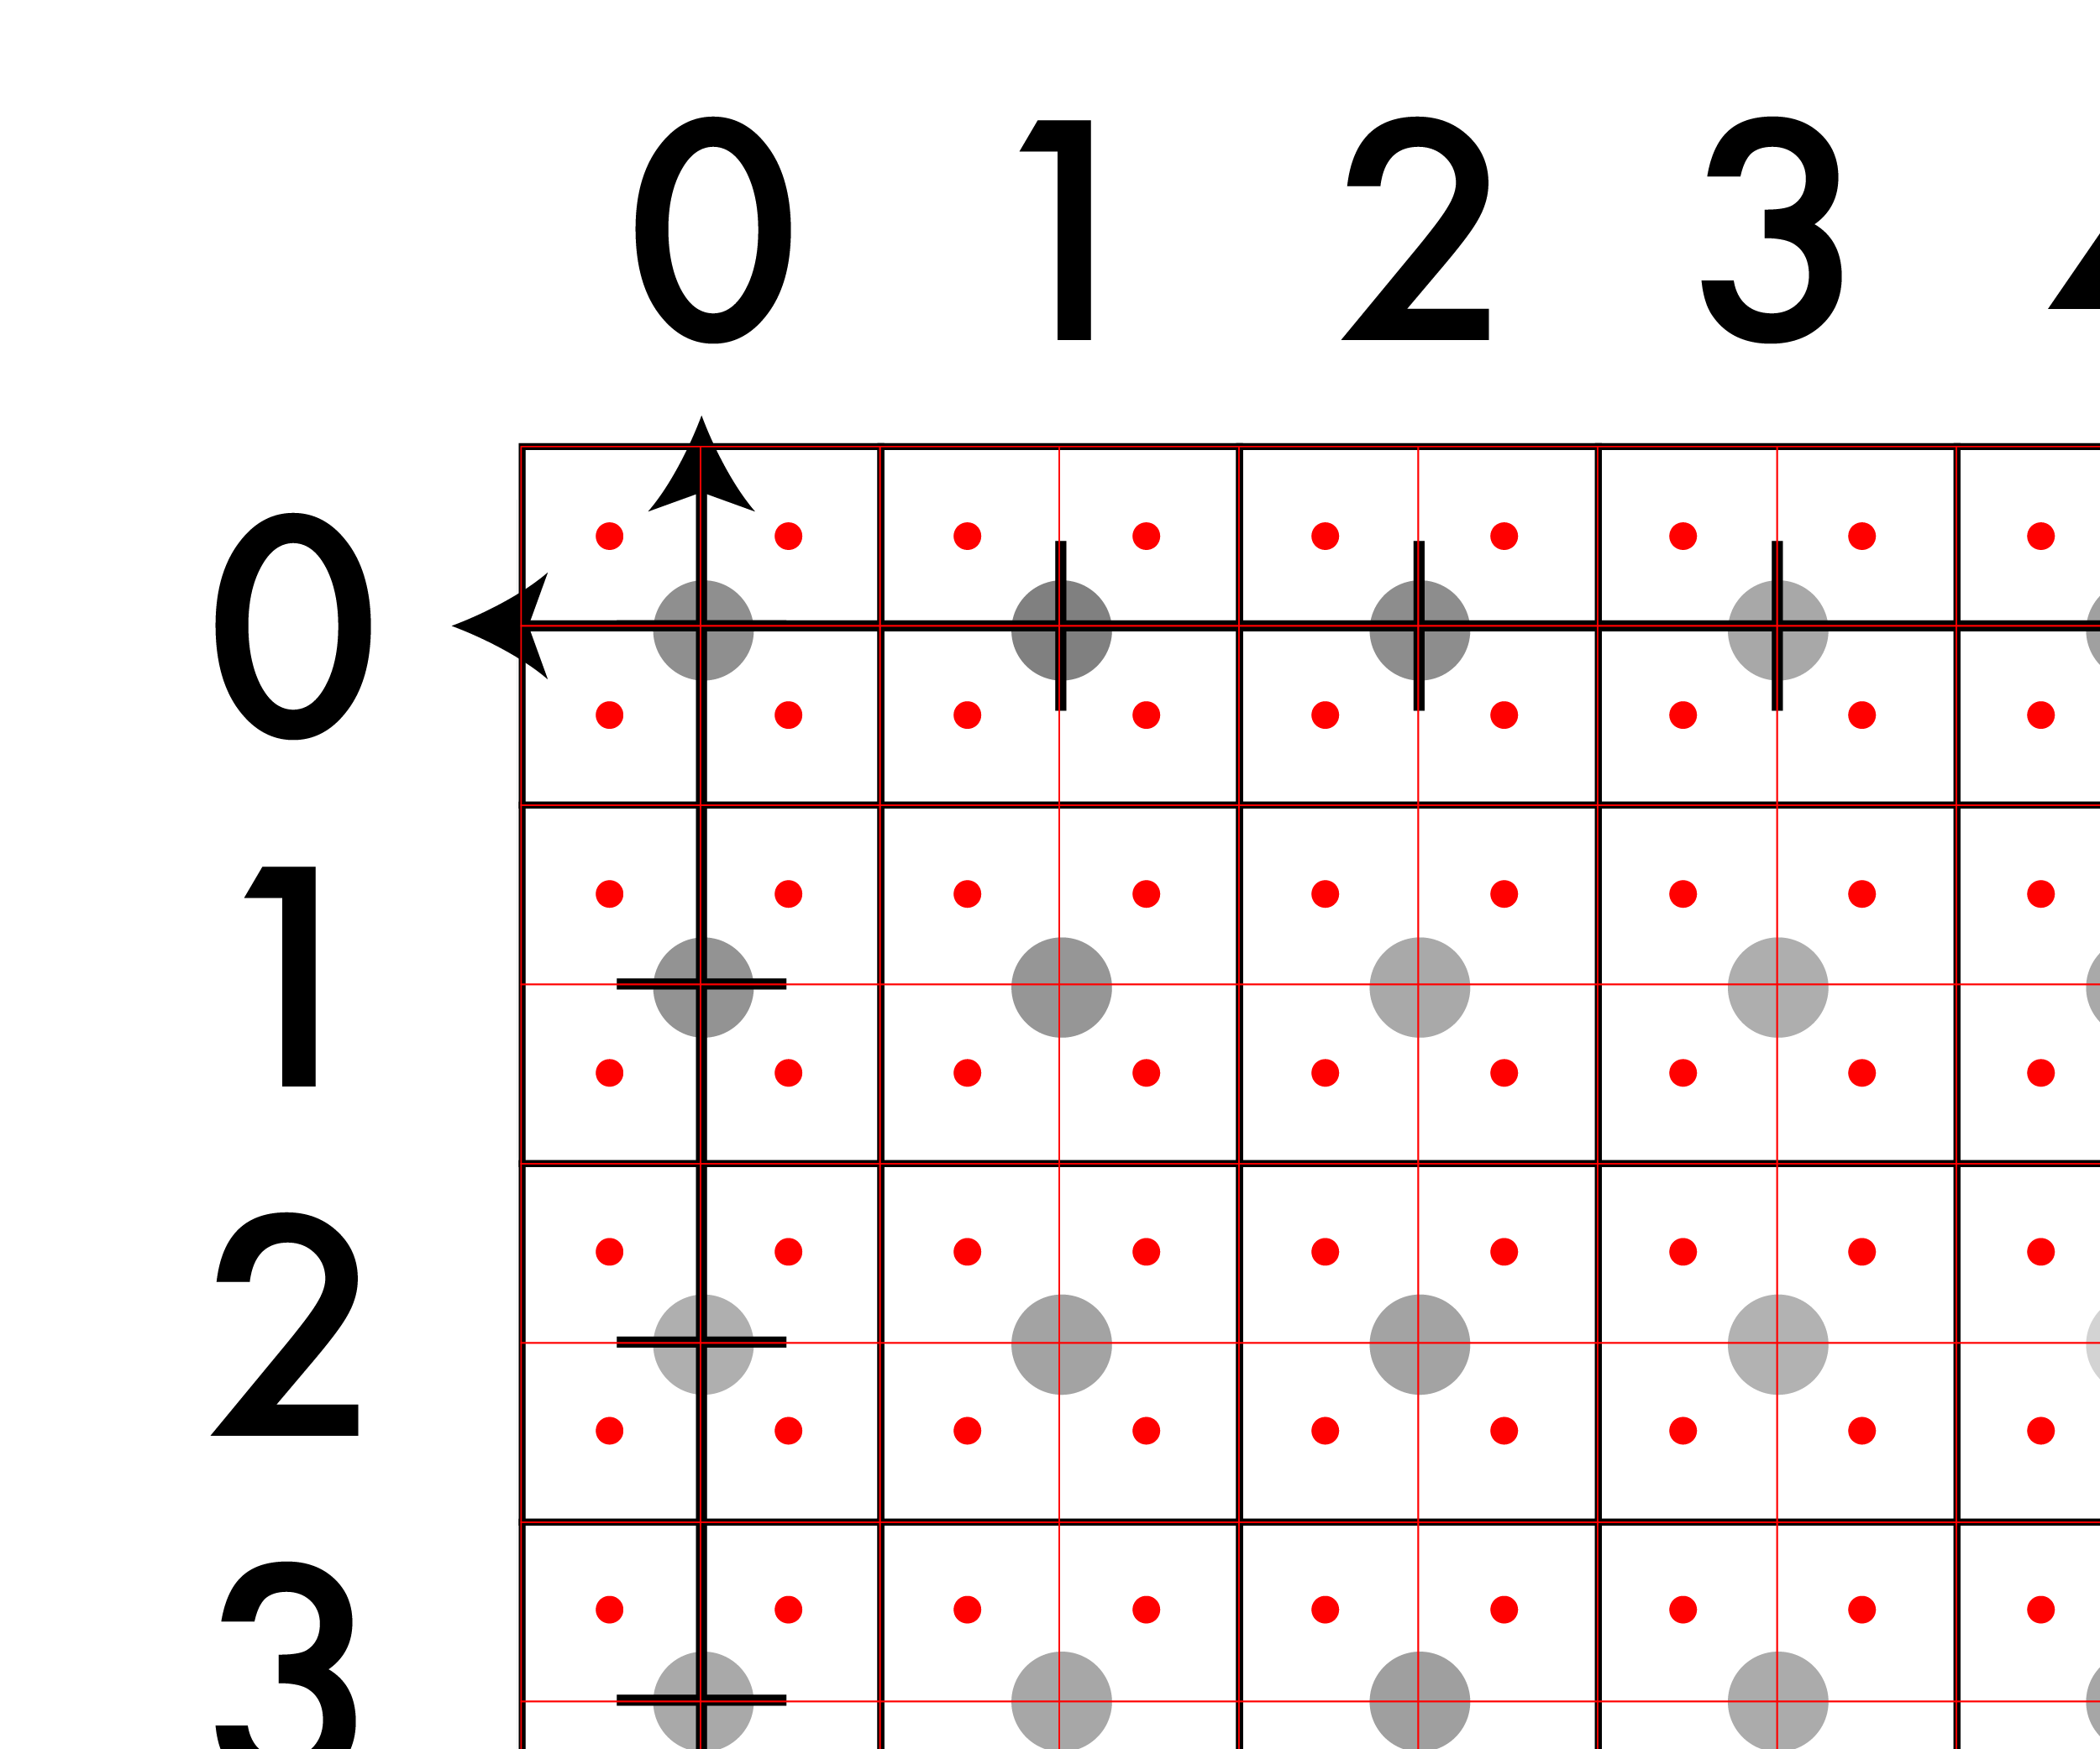
A note on coordinates in images

Slide 53
A note on coordinates in images
This point is:
(-.25, -.25)

Slide 54
Just be careful, lots of pitfalls
This point is:
(-.25, -.25)

Slide 55

Nearest neighbor: what it sounds like
f(x,y,z) = Im(round(x), round(y), z)
Looks blocky
Common pitfall: Integer division rounds down in C
Note: z is still int

Slide 56
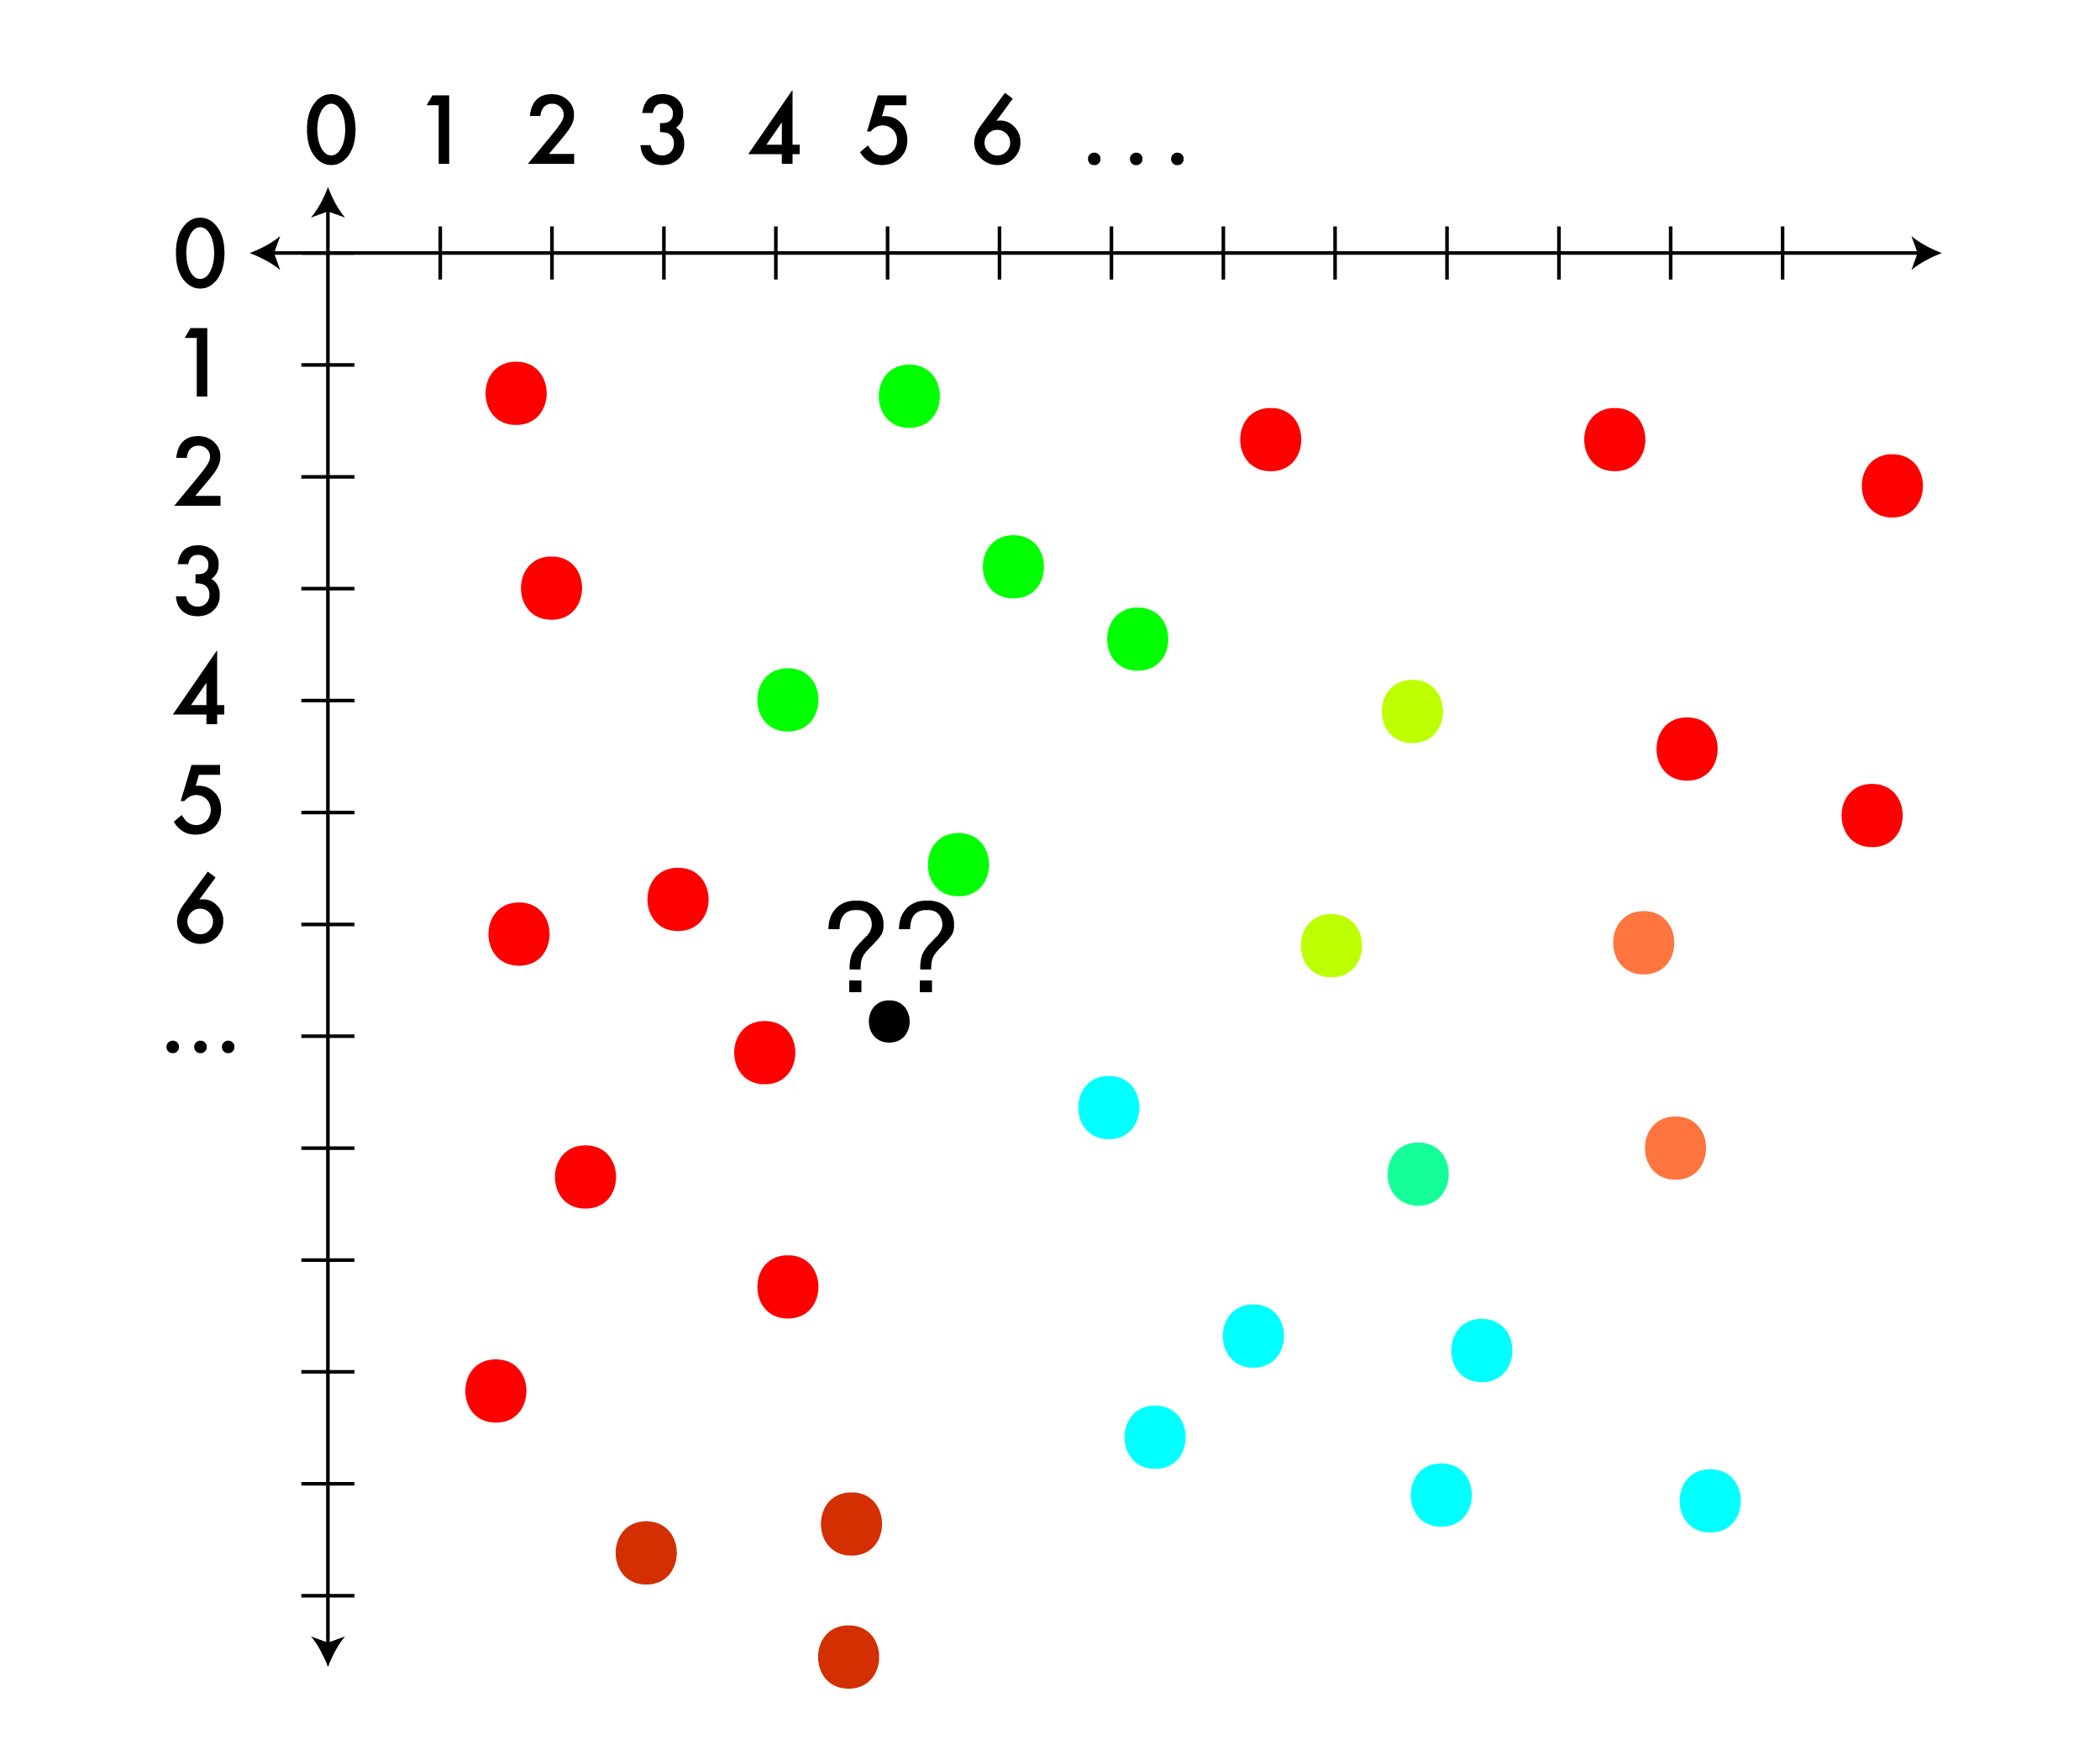
Triangle interpolation: for less structured image
Sometimes you have a regular grid, sometimes you don’t.
When you don’t look for triangles!

Slide 57
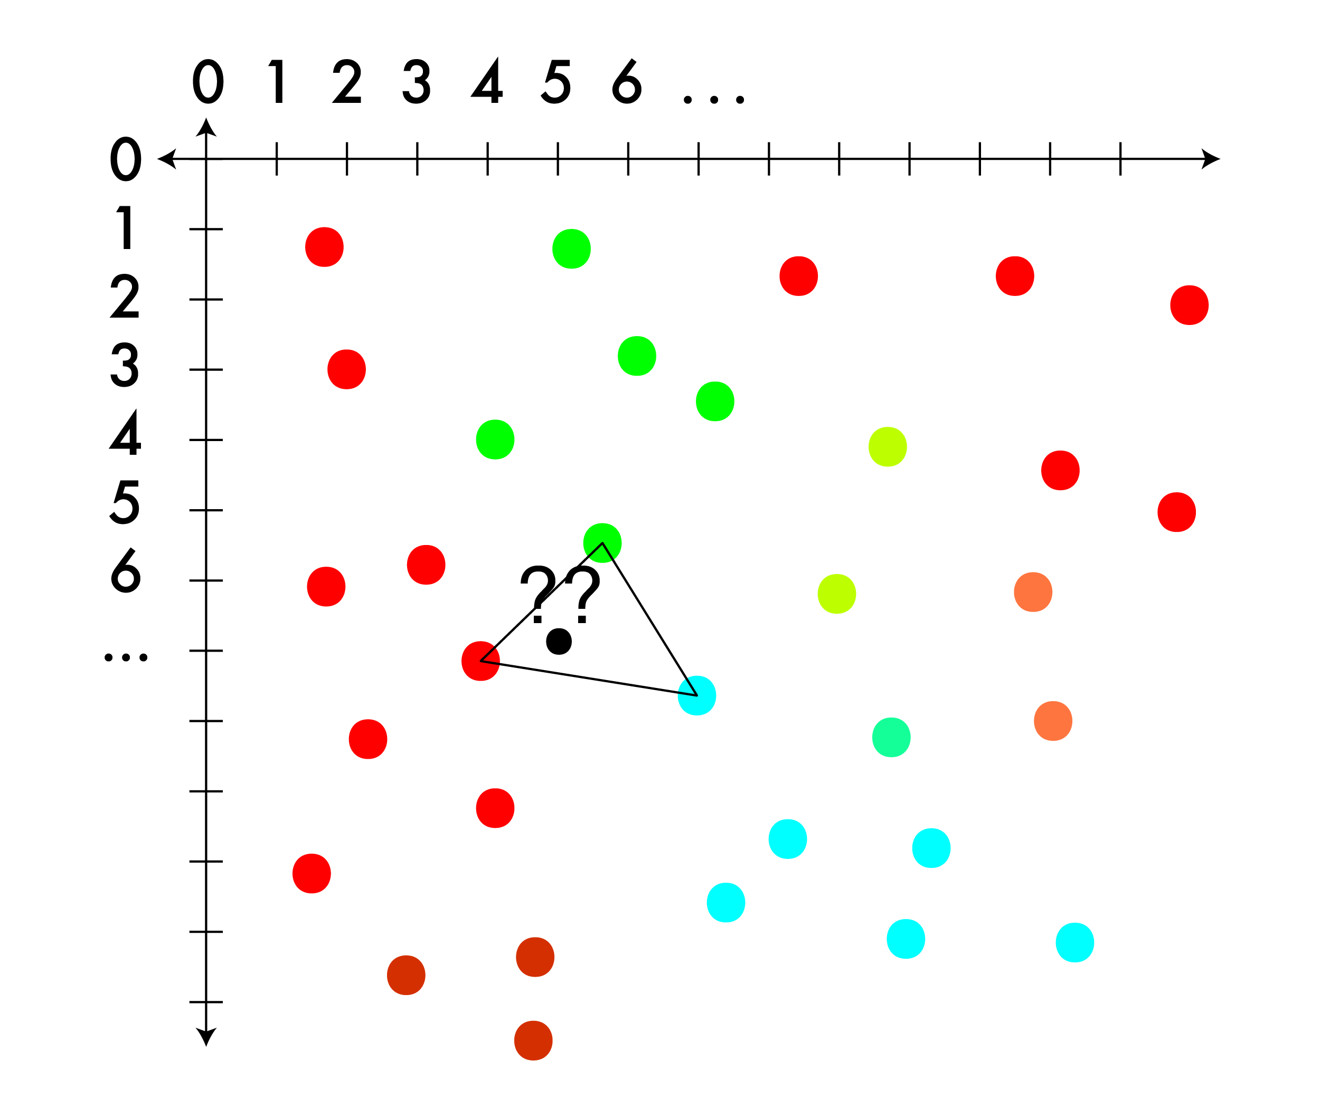
Triangle interpolation: for less structured image
Sometimes you have a regular grid, sometimes you don’t.
When you don’t look for triangles!

Slide 58
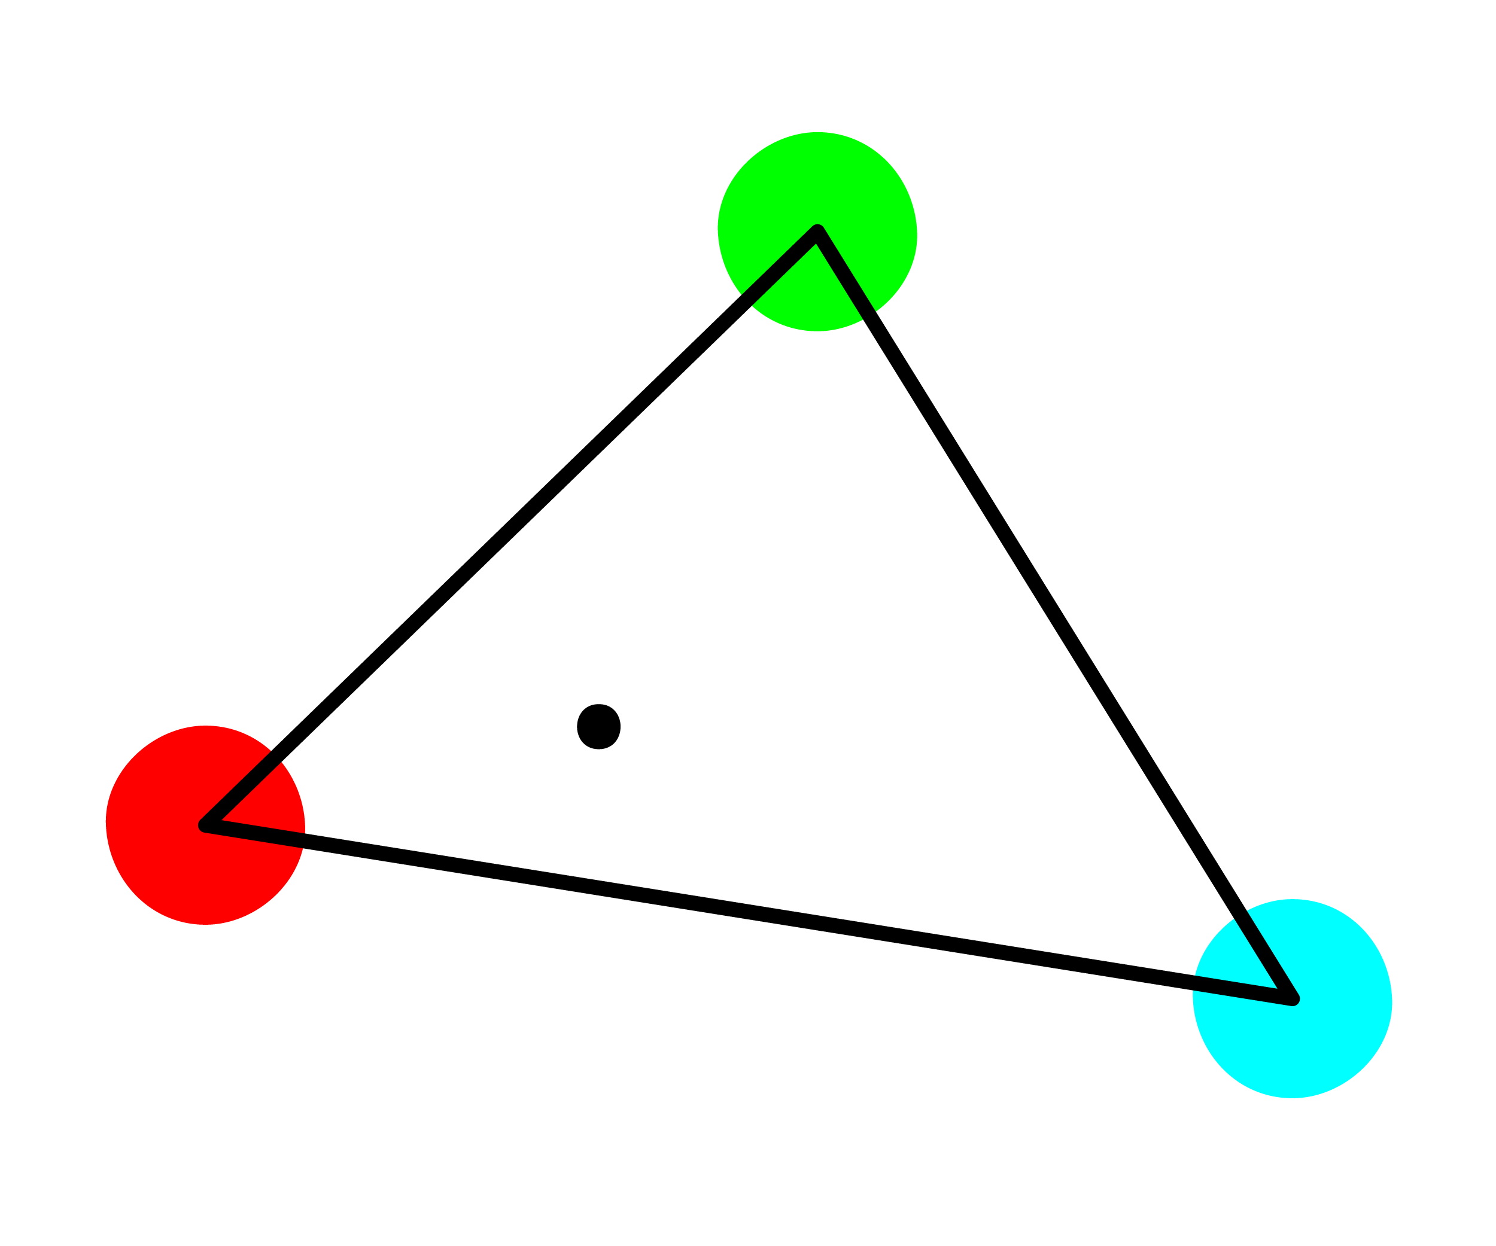
Triangle interpolation: for less structured image
Sometimes you have a regular grid, sometimes you don’t.
When you don’t look for triangles!

Slide 59
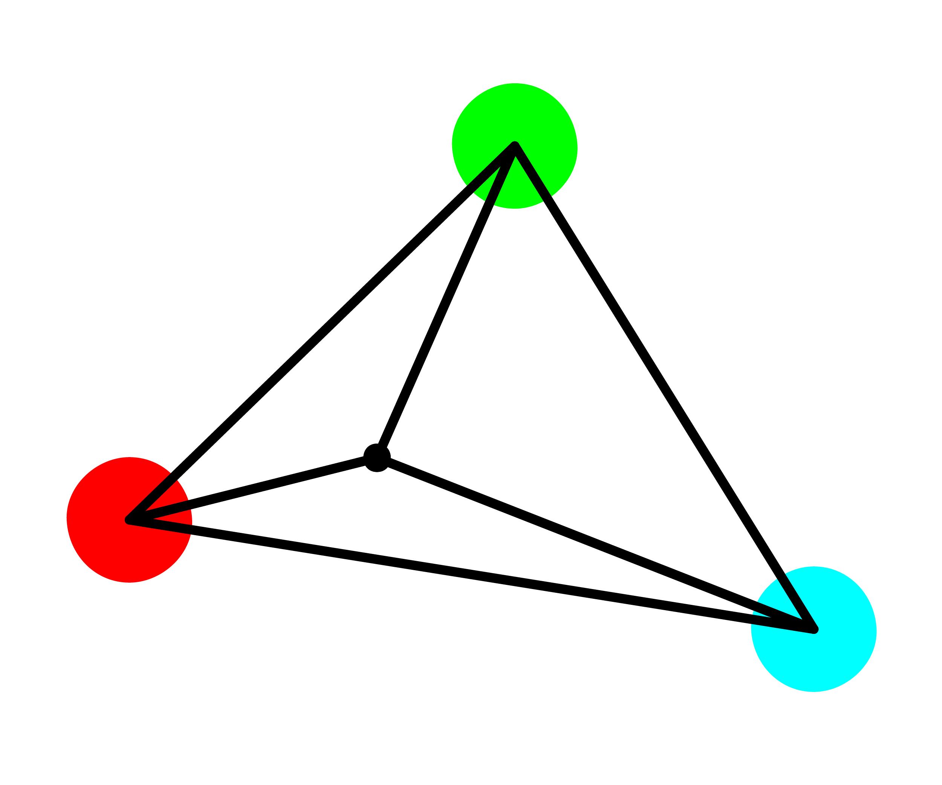
Triangle interpolation: for less structured image
Sometimes you have a regular grid, sometimes you don’t.
When you don’t look for triangles!

Slide 60
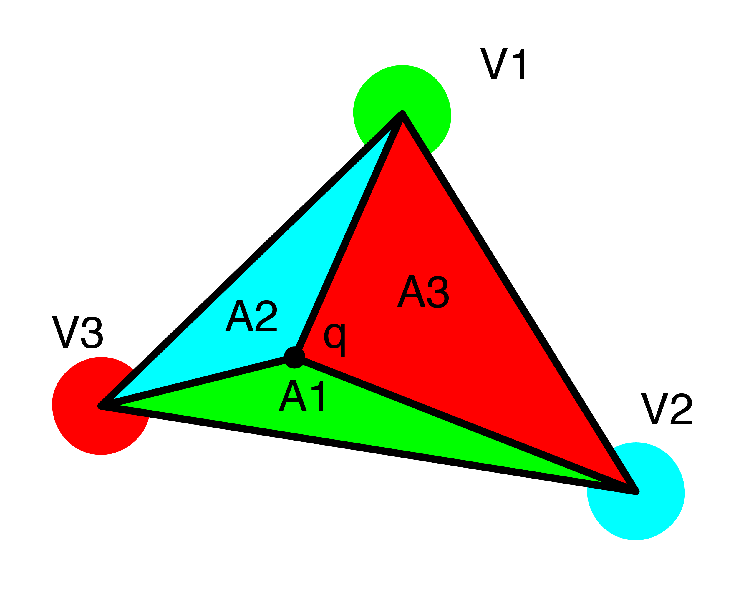
Triangle interpolation: for less structured image
Weighted sum using of triangles:
Q = V1*A1 + V2*A2 + V3*A3
Should normalize this based on total area

Slide 61

Bilinear interpolation: for grids, pretty good
This time find the closest pixels in a box

Slide 62

Bilinear interpolation: for grids, pretty good
This time find the closest pixels in a box

Slide 63

Bilinear interpolation: for grids, pretty good
This time find the closest pixels in a box

Slide 64

Bilinear interpolation: for grids, pretty good
This time find the closest pixels in a box
Same plan, weighted sum based on area of opposite rectangle
Q = V1*A1 + V2*A2 + V3*A3 + V4*A4
Still need to normalize!
Or do we?

Slide 65

Bilinear interpolation: for grids, pretty good
Alternatively, linear interpolation of linear interpolates
q1 = V1*d2 + V2*d1
q2 = V3*d2 + V4*d1
q = q1*d4 + q2*d3

Slide 66
Bilinear interpolation: for grids, pretty good
q1 = V1*d2 + V2*d1
q2 = V3*d2 + V4*d1
q = q1*d4 + q2*d3
Equivalent:
q = q1*d4 + q2*d3

Slide 67
Bilinear interpolation: for grids, pretty good
q1 = V1*d2 + V2*d1
q2 = V3*d2 + V4*d1
q = q1*d4 + q2*d3
Equivalent:
q = q1*d4 + q2*d3
q = (V1*d2 + V2*d1)*d4 + (V3*d2 + V4*d1)*d3 (subst)

Slide 68
Bilinear interpolation: for grids, pretty good
q1 = V1*d2 + V2*d1
q2 = V3*d2 + V4*d1
q = q1*d4 + q2*d3
Equivalent:
q = q1*d4 + q2*d3
q = (V1*d2 + V2*d1)*d4 + (V3*d2 + V4*d1)*d3 (subst)
q = V1*d2*d4 + V2*d1*d4 + V3*d2*d3 + V4*d1*d3 (distribution)

Slide 69
Bilinear interpolation: for grids, pretty good
q1 = V1*d2 + V2*d1
q2 = V3*d2 + V4*d1
q = q1*d4 + q2*d3
Equivalent:
q = q1*d4 + q2*d3
q = (V1*d2 + V2*d1)*d4 + (V3*d2 + V4*d1)*d3 (subst)
q = V1*d2*d4 + V2*d1*d4 + V3*d2*d3 + V4*d1*d3 (distribution)
Recall:
A1 = d2*d4
A2 = d1*d4
A3 = d2*d3
A4 = d1*d3

Slide 70
Bilinear interpolation: for grids, pretty good
q1 = V1*d2 + V2*d1
q2 = V3*d2 + V4*d1
q = q1*d4 + q2*d3
Equivalent:
q = q1*d4 + q2*d3
q = (V1*d2 + V2*d1)*d4 + (V3*d2 + V4*d1)*d3 (subst)
q = V1*d2*d4 + V2*d1*d4 + V3*d2*d3 + V4*d1*d3 (distribution)
Recall:
A1 = d2*d4
A2 = d1*d4
A3 = d2*d3
A4 = d1*d3
q = V1*A1 + V2*A2 + V3*A3 + V4*A4

Slide 71
Bilinear interpolation: for grids, pretty good
q1 = V1*d2 + V2*d1
q2 = V3*d2 + V4*d1
q = q1*d4 + q2*d3
Equivalent:
q = q1*d4 + q2*d3
q = (V1*d2 + V2*d1)*d4 + (V3*d2 + V4*d1)*d3 (subst)
q = V1*d2*d4 + V2*d1*d4 + V3*d2*d3 + V4*d1*d3 (distribution)
Recall:
A1 = d2*d4
A2 = d1*d4
A3 = d2*d3
A4 = d1*d3
q = V1*A1 + V2*A2 + V3*A3 + V4*A4
yay!

Slide 72

Bilinear interpolation: for grids, pretty good
Smoother than NN
More complex
4 lookups
Some math
Often the right tradeoff of speed vs final result

Slide 73

Bicubic sampling: more complex, maybe better?
A cubic interpolation of 4 cubic interpolations
Smoother than bilinear, no “star”
16 nearest neighbors
Fit 3rd order poly:
f(x) = a + bx + cx^2 + dx^3
Interpolate along axis
Fit another poly to interpolated values

Slide 74


Bicubic vs bilinear

Slide 75
Bicubic vs bilinear

Slide 76
Resize algorithm:
For each pixel in new image:
Map to old im coordinates
Interpolate value
Set new value in image

Slide 77

What about shrinking?
NN and Bilinear only look at small area
Lots of artifacting
Staircase pattern on diagonal lines
We’ll fix this next class with filters!

